Slide 1

What’s new in
Hybrid IT Infrastructure
Increasing efficiency and scalability with
Windows Server 2016 and Microsoft Azure
Hybrid IT Innovation Series
#InnovateIT

Slide 2
Presentation title
Module 2
Azure Infrastructure
Speaker Name
IT Innovation Series
#InnovateIT

Slide 3

Module agenda
Azure Infrastructure Fundamentals
Azure Compute & Storage
Azure Networking
Azure Resource Manager
Resources

Slide 4
Azure Infrastructure Fundamentals

Slide 6
Infrastructure for the
Intelligent Cloud
Hyper-scale
Hybrid
Trustworthy

Slide 7
Infrastructure for the
Intelligent Cloud
Hyper-scale
Hybrid
Trustworthy

Slide 8

24
Azure regions available today
More than AWS and Google Cloud combined
Azure regions
Only hyper-scale cloud provider to have presence in India

Slide 9
1.4
million miles of
fiber in our DCs
Datacenter
CDN Locations
Edge Node
Internet Exchange
Terrestrial Network
Subsea Network

Slide 10













Dublin*
Amsterdam
Seattle
Chicago
New York
London
Silicon
Valley
Washington DC
Tokyo
Atlanta
Osaka
Los Angeles
ExpressRoute
Dallas
Hong Kong
Chennai
Mumbai*
Privately connect from anywhere to any Azure region
Singapore
Sao Paulo
Sydney
Melbourne*

Slide 11
Infrastructure for the
Intelligent Cloud
Hyper-scale
Hybrid
Trustworthy

Slide 12
Hybrid Cloud
74%
65%
6X
ENTERPRISES BELIEVE
A HYBRID CLOUD
WILL ENABLE
BUSINESS GROWTH
MORE THAN 65 PERCENT
OF ENTERPRISE IT ORGANIZATIONS WILL COMMIT TO HYBRID CLOUD TECHNOLOGIES BEFORE 2016
GROWTH OF IT SPENDING ON PUBLIC CLOUD SERVICES IS 6X OF OVERALL IT MARKET
Avanade, Global Study: Hybrid Cloud–From Hype to Reality; December 2014
IDC Cloud Predictions for 2015; December 2014
IDC Press Release: http://www.idc.com/getdoc.jsp?containerId=prUS25219014; November 2014

Slide 13
Most Comprehensive Hybrid Cloud
Hybrid Cloud
HYBRID
STORAGE
StorSimple + Azure Storage
HYBRID
BACKUP + DR
Azure Backup + Azure Site Recovery
HYBRID
DATABASE
SQL Server 2016 StretchDB + Azure SQL DB
HYBRID
CONNECTIVITY
VPN + ExpressRoute
HYBRID
CONNECTIVITY
VPN + ExpressRoute
HYBRID
CONSISTENCY
Azure Stack + Cloud Platform System
HYBRID
APP INTEGRATION
Azure ServiceBus + BizTalk Services
HYBRID
IDENTITY
Azure Active Directory
HYBRID
CLOUD MANAGEMENT
Operations Management Suite + System Center

Slide 14
Azure Stack
Power of Azure with the control of the datacenter
Windows Server
Linux
Windows Server
Linux
Portal
IaaS | PaaS services
PLATFORM
CONSISTENCY
Portal
IaaS | PaaS services
Cloud-inspired infrastructure
Powered by Windows Server, Hyper-V,
System Center, and Azure technologies
Cloud infrastructure
Microsoft Azure Stack
Microsoft Azure

Slide 15
Begin the journey to hybrid cloud
Backup
and DR
Dev/Test infrastructure
>50%
workloads in public cloud
Lift and shift packaged apps
Cloud
native app development

Slide 16
Infrastructure for the
Intelligent Cloud
Hyper-scale
Hybrid
Trustworthy

Slide 17
SECURING THE PLATFORM
EMPOWERING YOU

Slide 18
Security
Privacy
Transparency
Compliance
    1B+ customers supported by Microsoft Cloud infrastructure
SECURING THE PLATFORM
EMPOWERING YOU
    240M user accounts in Azure
    127 countries across the globe

Slide 19
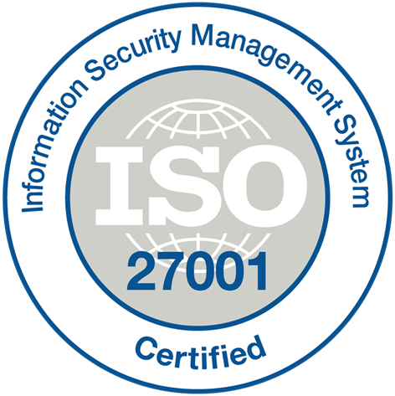





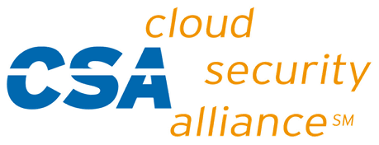





















Azure Compliance
The largest compliance portfolio in the industry
ISO 27001
SOC 1 Type 2
SOC 2 Type 2
PCI DSS Level 1
Cloud Controls
Matrix
ISO 27018
Content Delivery and
Security Association
Shared
Assessments
FedRAMP JAB P-ATO
HIPAA / HITECH
FIPS 140-2
21 CFR
Part 11
FERPA
DISA Level 2
CJIS
IRS 1075
ITAR-ready
Section 508 VPAT
European Union
Model Clauses
EU Safe Harbor
United Kingdom
G-Cloud
China Multi
Layer Protection Scheme
China
GB 18030
China
CCCPPF
Singapore
MTCS Level 3
Australian Signals
Directorate
New
Zealand
GCIO
Japan
Financial Services
ENISA
IAF

Slide 20
Key Vault
Virtual Networks
Network Security Groups
VPN + ExpressRoute
Azure Active Directory
Storage encryption
Partner solutions
Azure Security Center
SECURING THE PLATFORM
EMPOWERING YOU

Slide 21










Introducing
Azure Security Center
Gain visibility and control
Integrated security, monitoring, policy management
Built in threat detections and alerts
Works with broad ecosystem of security solutions

Slide 22
Azure Compute & Storage

Slide 23
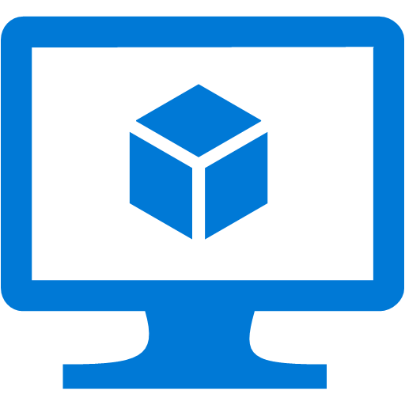
Azure Virtual Machines
Most flexible compute option
Supports Windows and Linux OS’s and most workloads
Create VMs with up to 32 processors and 448 GB of ram
Standard or SSD storage, up to 64TBs for the largest VMs
Built in capabilities for availability and scale

Slide 24

Azure Storage
Multi-tenant and highly scalable storage system
Automatic local redundancy (3 copies per file)
Enable geo-redundancy for +3 in a remote region
Standard storage or Premium (SSD)
Up to 5,000 IOPS per disk with Premium Storage!

Slide 25
Virtual Machine Storage Architecture
Azure Virtual Machine
C:\
OS Disk (127 GB)
D:\
Temporary Disk
(Contents can be lost)
E:\, F:\, etc.
Data Disks (1 TB)
Disk Cache
Azure Blob
Notes:
Bryon
When you look at the deployment of storage. A normal VM that gets deployed gets 2 disks right off the bat. For Windows you get your c:\ which has a cache attached to it and a d:\ drive which is temporary. You do not want to put anything critical or stateful on the d-drive – it is ment to be temporary and not designed for persistent storage.
The C-Drive end up being backed by Azure blobs. These are just your standard blobs in Azure. If you attach any additional data disks – these are also backed by Azure blobs.
Up to 64 1TB disks attached to a single system

Slide 26
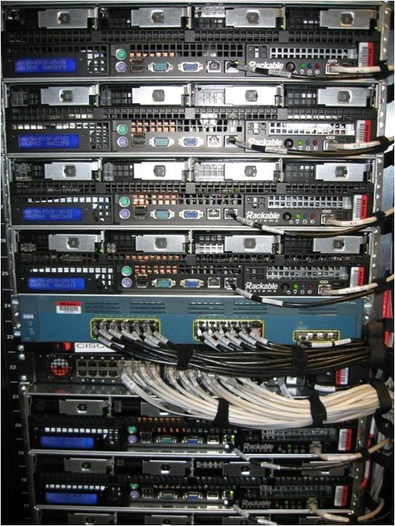
Automatic Physical Redundancy
Availability sets deploy your virtual machines
on redundant hardware automatically

Slide 27
Geo-Replication
Virtual Machine Storage
Defend against regional disasters
East DC
> 400 miles
West DC
Geo replication
Notes:
Bryon
So another aspect that you get free out of Azure storage is Geo-replication. Just by flipping this on, you can actually geo-replicate across regions to help safeguard against regional disasters.
What’s also interesting is that the geo-replicas can be read-accessed. So you can get access to the replicated data, to validate the data, make sure they look right. You can even pull them aside and do testing against them and you can even do BI against the data without disrupting the content. This is all possible using the geo-replication feature in Azure Storage.
______________________
Additionally, data is asynchronously copied to another datacenter that’s at least 400 miles away.
So you can be sure that every piece of data that you store in the Azure Blob is available as well as protected against regional disasters (we call this geo-replication).
Geo replication is a unique feature, that differentiates us from competition.

Slide 28
Resource groups
Container for multiple resources
Manage resources as a single unit
  Resources exist in one* resource group
  Resource groups can span regions
  Resource groups can span services
Role Based Access and Control
(RBAC) on groups or resources
Billing integrated tagging on
groups or resources
RESOURCE GROUPS
*and only one

Slide 29
Scale-up options
Highest value
Largest scale-up
A
D
DV2
G
N
Highest value
SSD Storage
Fast CPUs
New generation
of D family VMs
Most memory
fastest CPUs
GPU-enabled
virtual machines
>80,000 IOPs
Premium Storage
35% faster than D
Intel E5-2673 v3 CPUs
NVIDIA GPUs
Remote visualization
Compute-intensive + RDMA
Largest virtual machines
Fastest storage in the public cloud

Slide 30
N family of virtual machines
Introducing
N
First to offer NVIDIA M60 GPU NVIDIA K80 for CUDA compute
RDMA for multi-machine multi-GPU workloads
Validated ISV applications

Slide 31
Lab
Azure Compute
Notes:
For this lab, you should be working from the ITI – Intro to Azure Infrastructure, specifically the Compute Lab

Slide 32
Premium storage
Virtual machine
High bandwidth with low latency
Up to 64TB storage per VM
Up to 80,000 IOPS per VM
Up to 5,000 IOPS per disk
Up to 2,000MB per sec bandwidth per VM
~5 ms read/write (no cache)
Less than 1 ms read latency (cache)
Uncached
disk
Cached
disk
Local
disk
Disk provisioning
Disk provisioning
SSD provisioning
Cache miss
Cache hit
VM/network provisioning
Server SSD
Premium storage
blobs
Notes:
Premium Storage: High-Performance Storage for Azure Virtual Machine Workloads%
https://azure.microsoft.com/en-us/documentation/articles/storage-premium-storage-preview-portal/
You can use Premium Storage for Disks in one of two ways:
Create a new premium storage account first and then use it when creating the VM
Create a new DS-series or GS-series VM
While creating the VM, you can select a previously created Premium Storage account, create a new one, or let the Azure Portal to create a default premium account
Tip: To leverage the benefit of Premium Storage, create a Premium Storage account using an account type of Premium_LRS first. To do this, you can use the Microsoft Azure Preview Portal, Azure PowerShell, or the Service Management REST API
Azure uses the storage account as a container for your operating system (OS) and data disks
If you create an Azure DS-series or GS-series VM and select an Azure Premium Storage account, your operating system and data disks are stored in that storage account

Slide 33
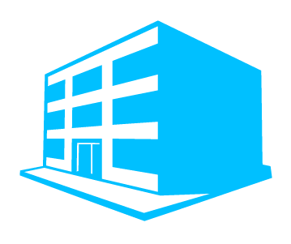
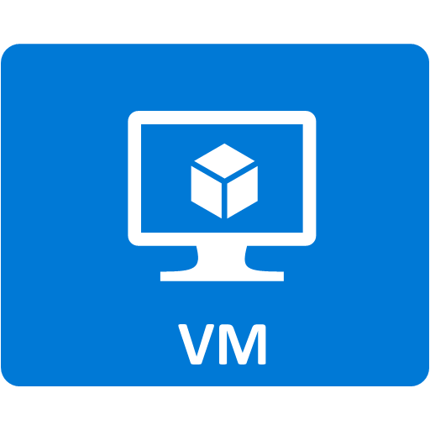
Azure scale unit (Azure Compute Cluster)
Definition
  A compute unit capable of supporting
  a defined range of VM sizes
  Each cloud service is bound to a
  single scale unit
  Each affinity group with one or more
  VM is bound to a single scale unit
Impact of resize
  VMs can only be resized to a size supported
  on scale unit where the VM is deployed
Scale unit
1
2
Scale unit
Notes:
Sizes for virtual machines at
https://azure.microsoft.com/en-us/documentation/articles/virtual-machines-size-specs/

Slide 34
Azure VM pricing tiers
Basic
  Scale Unit 1: A0-A4
  (original VM sizes)
  No load Balancing, no autoscale (can only scale between A0-A4)
    For small to medium applications or workloads
Standard
  Scale Unit 2: A0-A7
  (like SU1 but adds A5-A7)
  Scale Unit 3: A8/A9
  (“HPC” VMs, optimized networking with Infiniband)
  Scale Unit 4: A0-A7 and D1-D14 (D’s series with SSDs and better CPUs, and all A0-A7)
  Scale Unit 5: G1-G5
  (monster powerful VMs up to 32 core Xeon CPUs/448 GB RAM/6596 GB SSD storage/64 data disks)
Premium
  Available for DS and
  GS series VMs
Notes:
Virtual Machines Pricing
https://azure.microsoft.com/en-us/pricing/details/virtual-machines/
New D-Series Virtual Machine Sizes
https://azure.microsoft.com/en-us/blog/new-d-series-virtual-machine-sizes/
Largest VM in the Cloud
https://azure.microsoft.com/en-us/blog/largest-vm-in-the-cloud/
How to choose scale unit
To ensure you get a SU that will meet your needs for scaling up, ensure the first VM deployed in that Cloud Service (or legacy Affinity Group) is in the upper range. So if you want SU2, deploy an S5 or above (S6 or S7) and you will be in SU2 at that point for all subsequent allocations. When you deploy a smaller size, like A2, you can get put into many different scale units. You won’t necessarily be in SU1.

Slide 35
Multiple storage accounts are often required!
To avoid throttling
Throttling is done per disk
  By family and by storage
Max of 20,000
IOPS/ standard Storage Account
VM size | CPU cores | Max disk IOPS (per VM) | Max disk bandwidth (per VM) | Cache size (GB)
STANDARD_DS1 | 1 | 3,200 | 32 MB per second | 43
STANDARD_DS2 | 2 | 6,400 | 64 MB per second | 86
STANDARD_DS3 | 4 | 12,800 | 128 MB per second | 172
STANDARD_DS4 | 8 | 25,600 | 256 MB per second | 344
STANDARD_DS11 | 2 | 6,400 | 64 MB per second | 72
STANDARD_DS12 | 4 | 12,800 | 128 MB per second | 144
STANDARD_DS13 | 8 | 25,600 | 256 MB per second | 288
STANDARD_DS14 | 16 | 50,000 | 512 MB per second | 576
STANDARD_GS1 | 2 | 5000 | 125 MB per second | 264
STANDARD_GS2 | 4 | 10,000 | 250 MB per second | 528
STANDARD_GS3 | 8 | 20,000 | 500 MB per second | 1056
STANDARD_GS4 | 16 | 40,000 | 1,000 MB per second | 2112
STANDARD_GS5 | 32 | 80,000 | 2,000 MB per second | 4224
Storage disk type | P10 | P20 | P30
Disk size | 128 GiB | 512 GiB | 1024 GiB (1 TB)
IOPS per disk | 500 | 2300 | 5000
Throughput per disk | 100 MB per second | 150 MB per second | 200 MB per second

Slide 36
How many storage accounts?
It depends… what is the limiting factor (disk or VM)?
  EXAMPLE:
  5 VMs on P30 storage disk (5000 IOPS max). OR
  A single VM with 5 P30 disks striped = 25,000 IOPS
  So, in both cases 2 storage accounts are required to achieve 25,000 IOPS
  EXAMPLE:
  VMs capable of achieving 12,000 IOPS/disk. Assuming they do…
  (3 x 12,000=36,000)\20,000 = 2 storage accounts
  EXAMPLE:
  Maximum allowable disk capacity for premium storage accounts is 35 TB
  To accommodate the 64 1 TB disks allowed for a G5 VM, you would need
  2 storage accounts
  OR
=
12,000 IOPS/disk
=
Maximum: 35 TB

Slide 37
Azure storage types
  Block blobs, page blobs and disks, tables and queues, and files
 | Locally Redundant Storage (LRS) | Zone Redundant Storage (ZRS) | Geographically Redundant Storage (GRS) | Read-Access Geographically Redundant Storage (RA-GRS)
How it works | Makes multiple synchronous copies of your data within a single datacenter | Stores three copies of data across multiple datacenters within or across regions. For block blobs only | Same as LRS, plus multiple asynchronous copies to a second datacenter hundreds of miles away | Same as GRS, plus read access to the secondary datacenter
Total copies | 3 | 3 | 6 | 6
Why use it | For economical local storage or data governance compliance | An economical, higher durability option for block blob storage | For protection against a major datacenter outage or disaster | Provides read access to data during an outage, for maximum data availability and durability
Availability SLA | 99.9% read/write | 99.9% read/write | 99.9% read/write | 99.9% write 99.99% read
https://azure.microsoft.com/en-us/pricing/details/storage/
Notes:
How Azure pricing works
https://azure.microsoft.com/en-us/pricing/details/storage/

Slide 38
Temporary drive guidance
Never place critical unreplicated data
on temp drive!!
Use for SQL TempDB and Buffer Pool Extension on D-Series and G-Series VM sizes only (SSD temp disks)
  http://blogs.technet.com/b/dataplatforminsider/archive/2014/09/25/using-ssds-in-azure-vms-to-store-sql-server-tempdb-and-buffer-pool-extensions.aspx
Use scheduled tasks to configure temporary disk
Test scheduled tasks via resize
VM operation
Azure virtual machine
C:\
OS disk
D:\
temporary disk
E:\,F:\, etc.
data disks
Disk cache
Azure blob
Notes:
Virtual Machines Documentation
https://azure.microsoft.com/en-us/documentation/services/virtual-machines/

Slide 39
Temporary drive performance (D-Series)
Cores | VM sizes | Temp disk size (GB) | Max IOPS | Max read (MB/s) | Max write (MB/s)
1 | Standard_D1 | 50 | 3,000 | 48 | 24
2 | Standard_D2 Standard_D11 | 100 | 6,000 | 96 | 48
4 | Standard_D3 Standard_D12 | 200 | 12,000 | 192 | 96
8 | Standard_D4 Standard_D13 | 400 | 24,000 | 384 | 192
16 | Standard_D14 | 800 | 48,000 | 768 | 384
http://azure.microsoft.com/blog/2014/10/06/d-series-performance-expectations/
Notes:
Azure Storage Scalability and Performance Targets
https://azure.microsoft.com/en-us/documentation/articles/storage-scalability-targets/

Slide 40
Key concepts – Service Manager
Hierarchy
Limits and locking
Subscription
Object | Limit | Locking
Subscription | 120 create/add operations in 5 minute window | N/A
Cloud service | 200 per subscription | ~3 minutes per update
Virtual machine | 50 per cloud service 2048 per virtual network | None
Virtual network | 100 per subscription | Single modification API
Storage account | 100 per subscription | None
Storage container | No limit | None
Storage blob | 40 per storage account | One blob per container per storage account at a time
Cloud service (200)
Virtual machine (50x200)
Virtual network (100)
Storage account (100)
Storage container
Storage blob (40x100)
http://azure.microsoft.com/en-us/documentation/articles/azure-subscription-service-limits/
Notes:
Only applies to Service Manager environment

Slide 41
Know Your Limits – Resource Manager
Resource | Default Limit | Maximum Limit
Cores per subscription | 20¹ per Region | 10,000 per Region
Co-administrators | Unlimited | Unlimited
Storage accounts | 100 | 100²
Resource Groups | 800 | 800
Resource Manager API Reads | 15000 per hour | 15000 per hour
Resource Manager API Writes | 1200 per hour | 1200 per hour
Resource Manager API request size | 4194304 bytes | 4194304 bytes
VMs per Availability Set | 100 | 100
IO/ps to a standard storage account | 20k | 20k
Notes:
1 can be increased easily with a support request on a per region basis
2 requires additional subscription

Slide 42
Large deployment guidance
Deploy VMs in blocks
  Block size: Minimum of Total VMs / 5 -or- 100
  Deploy one VM per cloud service; use common availability set in each cloud service
  Wait 5 minutes between starting each block of VMs to avoid throttling
Limit use of Get* APIs during deployment
  Limits possibility of throttling
  Back-off if any 503-ServiceUnavailable or 429-TooManyRequests errors are received
Use virtual network for connectivity
Custom image management
  If using a custom OS image then place up to 40 OS disks in a storage account
Notes:
Best Practices for Large Deployments of Azure Nodes with Microsoft HPC Pack
https://technet.microsoft.com/en-us/library/jj994092.aspx
Designing for Big Scale in Azure
http://blogs.msdn.com/b/kdot/archive/2014/10/09/designing-for-big-scale-in-azure.aspx

Slide 43
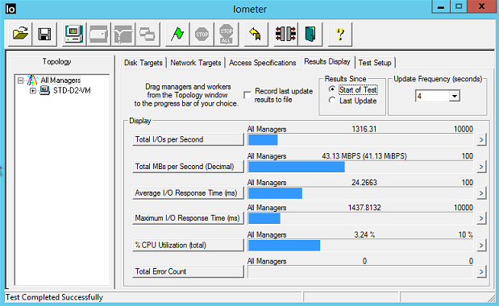
Iometer
An I/O subsystem measurement
and characterization tool for
single and clustered systems
Used as a benchmark and troubleshooting tool
Easily configured to replicate
the behavior of many popular applications
One commonly quoted measurement provided by
the tool is IOPS
Notes:
http://www.iometer.org/

Slide 44
Azure File Storage
Fully Managed File Shares in the Cloud
Connect to Azure Files from On-Prem or Cloud
Based on industry standard SMB 3.0; Secure + Reliable
Migrate apps with no code changes
High availability, durability, and cross-region redundancy
Designed for IT Pros and Devs—Azure Portal, File Explorer, CLI, and REST APIs
Migrate apps
APPS
SERVER
APPS
SERVER
On-premises connectivity
SMB
File Server/Share
SMB
Migrate server data
File Storage
Azure Storage
On Premise
Azure

Slide 45

Example: Sharing server data
Between on-premises and the cloud
Migrate server data—server log files, event data, and backup files
Simplified management—Azure Portal, PowerShell, Azure CLI
SMB 3.0 encryption enables secure external access
ExpressRoute support for reliable, predictable, and private connectivity
SMB3.0
SMB3.0
On-Premises
Azure US-East
Azure US-West

Slide 46
Lab
Azure Storage
Notes:
For this lab, you should be working from the ITI – Intro to Azure Infrastructure, specifically the Storage Lab

Slide 47
Azure Networking

Slide 48

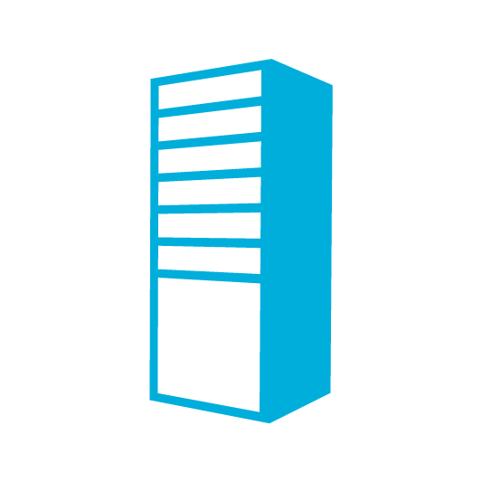


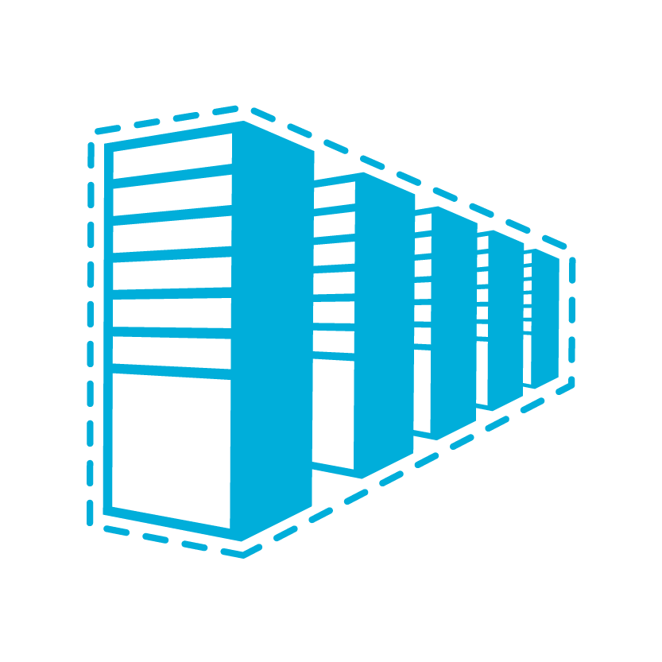

Azure Virtual Network
Bring your own network
Logical isolation with control
over network
Create subnets with your private
or public IP address spaces
Bring your own DNS or use
Azure-provided DNS
Secure VMs with Network
Security Groups
Run highly available internal services behind internal load balancer
INTERNET
DIRECT INTERNET
CONNECTIVITY
ON-PREMISES
VIRTUAL NETWORK
AZURE INFRA
ROUTER
NETWORK SECURITY GROUP
WEB FIREWALL
DNS
WEB
SERVER
AD
FE SUBNET
LOAD BALANCER
AZURE INTERNAL LB
APP SERVERS
DB SERVERS
BE SUBNET
Notes:
Azure Virtual Network
https://azure.microsoft.com/en-us/services/virtual-network/
Virtual Network Documentation
https://azure.microsoft.com/en-us/documentation/services/virtual-network/

Slide 49

Internet IP addresses and load balancing
Public IP addresses in Azure
  Can be used for instance (VM) level access or
  load balancing
Instance-level IP
  Internet IP assigned exclusively to single VM
  Entire port range accessible by default
  Primarily for targeting a specific VM
Load balanced IP (VIP)
  Internet IP load balanced among one or
  more VM instances
  Allows port redirection
  Primarily for load balanced, highly available,
  or auto-scale scenarios
INTERNET
INTERNET
151.2.3.4 (VIP)
LB
131.3.3.3
(INSTANCE-LEVEL IP)
131.3.4.4
(INSTANCE-LEVEL IP)
VM1
VM2
IP1
IP2
Notes:
Instance Level Public IP Overview
https://azure.microsoft.com/en-us/documentation/articles/virtual-networks-instance-level-public-ip/

Slide 50
Reserved IPs can move!
Retain your IP addresses
IPs on existing services can
be reserved
IPs can be moved between services in seconds
INTERNET
RESERVED IP
AZURE LOAD BALANCER
RESERVED IP MOVES
CLOUD SERVICE 1
CLOUD SERVICE 2
Notes:
Reserved IP addresses for Cloud Services & Virtual Machines
https://azure.microsoft.com/en-us/blog/reserved-ip-addresses/
Azure Datacenter IP Address Ranges
https://msdn.microsoft.com/en-us/library/azure/dn175718.aspx

Slide 51
DNS names for public IP
FQDN access to a
virtual machine
Available for virtual machines and web/worker roles
Automatic DNS registration/
de-registration during
scale-up, scale-down
INTERNET
WEBROLE.0.CONTOSO.CLOUDAPP.NET 130.26.10.80
WEBROLE.0.CONTOSO.CLOUDAPP.NET 130.26.10.80
CONTOSO APP WITH 2 VIRTUAL MACHINES
VM INSTANCE 1
VM INSTANCE 2
Notes:
Azure DNS
https://azure.microsoft.com/en-us/services/dns/

Slide 52
User Defined Routes (UDR)
Control traffic flow in your network with custom routes
Attach route tables to subnets
Specify next hop for
any address prefix
Set 0/0 route to force
tunnel all traffic to
on-premises or appliance
INTERNET
UDR
SYSTEM ROUTE
“IP FORWARDING”
FRONTEND SUBNET
BACKEND SUBNET
SYSTEM ROUTE
VM/APPLIANCE
UDR
“IP FORWARDING”
Notes:
User Defined Routes and IP Forwarding
https://azure.microsoft.com/en-us/documentation/articles/virtual-networks-udr-overview/

Slide 53



Multiple NICs in Azure VMs
Up to 16 NICs per VM
NSG and routes on all NICs
Can separate frontend, backend, and management
VIRTUAL NETWORK
VIRTUAL MACHINE
NIC2
NIC1
DEFAULT
10.3.3.33
10.2.2.22
10.1.1.11
VIP 133.44.55.66
INTERNET
BACKEND
SUBNET
MGMT
SUBNET
FRONTEND
SUBNET
Notes:
Multiple VM NICs and Network Virtual Appliances in Azure
https://azure.microsoft.com/en-us/blog/multiple-vm-nics-and-network-virtual-appliances-in-azure/
Create a Multi-NIC VM with a Public IP in Azure
http://blogs.msdn.com/b/rslaten/archive/2014/11/18/create-a-multi-nic-vm-with-a-public-ip-in-azure.aspx
Create a VM with multiple NICs
https://azure.microsoft.com/en-us/documentation/articles/virtual-networks-multiple-nics/

Slide 54
Picking the right connectivity model
INTERNET / VPN GATEWAYS
EXCHANGE PROVIDER
NETWORK SERVICE PROVIDER
Connect via an encrypted link over
public internet
Peer at an ExpressRoute location, an Exchange provider facility
Connection from WAN provided
by network service provider
Azure becomes another site on the customer’s WAN
MICROSOFT
CLOUD
PUBLIC
INTERNET
PUBLIC
INTERNET
MICROSOFT
CLOUD
CUSTOMER
SITE 3
CUSTOMER
SITE 2
MICROSOFT
CLOUD
WAN
CUSTOMER
SITE 1
PUBLIC
INTERNET
CUSTOMER
SITE
CUSTOMER
SITE
EXPRESSROUTE
PARTNER LOCATION
INTERNET-BASED CONNECTIVITY
EXPRESSROUTE –
PROVIDES CUSTOMER CHOICE AND INCLUDES ACCESS TO ALL MICROSOFT CLOUD SERVICES
Notes:
About VPN Devices and Gateways for Virtual Network Connectivity
https://msdn.microsoft.com/en-us/library/azure/jj156075.aspx
ExpressRoute
https://azure.microsoft.com/en-us/services/expressroute/
ExpressRoute Pricing
https://azure.microsoft.com/en-us/pricing/details/expressroute/
New Networking features and partnerships for Enterprise scenarios
https://azure.microsoft.com/en-us/blog/networking-enterprise/

Slide 55
VPN Gateways for Virtual Network
ExpressRoute gateway or VPN gateway needed
to access a virtual network
Introducing a new Standard Gateway
  Supports ExpressRoute and VPN coexistence
  Improved throughput for ExpressRoute
VIRTUAL NETWORK GATEWAY SKU | EXPRESSROUTE GW THROUGHPUT | VPN GW EXPRESSROUTE COEXISTENCE | VPN GW THROUGHPUT | VPN GW MAX IPSEC TUNNELS | COST (USD) / HOUR
BASIC | 500 MBPS | NO | 100 MBPS | 10 | $0.04
STANDARD | 1000 MBPS | YES | 100 MBPS | 10 | $0.19
PERFORMANCE | 2000 MBPS | YES | 200 MBPS | 30 | $0.49
NOTE THAT EXPRESSROUTE TRAFFIC FOR AZURE PUBLIC SERVICES, O365, AND SKYPE FOR BUSINESS
DOES NOT GO THROUGH A VIRTUAL NETWORK GATEWAY
Notes:
Azure Standard VPN Gateway
https://azure.microsoft.com/en-us/updates/azure-standard-vpn-gateway/

Slide 56
Cloud Services: Layered security, protection, and isolation
INTERNET
CLOUD SERVICES
AND
VIRTUAL MACHINES
VIRTUAL
NETWORK
ISOLATION
VM
FIREWALL
NSG
ACLS
DDOS
PROTECTION
ON-PREMISES
Notes:
Cloud basics - Security in the cloud
http://www.microsoft.com/industry/government/guides/cloud_computing/3-security.aspx
Microsoft Azure Trust Center: Security
https://azure.microsoft.com/en-us/support/trust-center/security/

Slide 57
Network Security Groups
Segment network to meet
security needs
Prioritized set of rules
  Default rules: 65,000 and above
Applied at the VM and/or subnet
Applies to internal and external traffic
Default tags: Virtual Network,
Internet, Azure load balancer
API audit logs
ON PREMISES 10.0/16
INTERNET
EXPRESS
ROUTE
AND VPNs
✓
✗
✗
✓
✓
✓
VPN GW
BACKEND
10.3/16
MID-TIER
10.2/16
FRONTEND
10.1/16
VIRTUAL NETWORK
✗
Notes:
Network Security Groups
https://azure.microsoft.com/en-us/blog/network-security-groups/
What is a Network Security Group (NSG)?
https://azure.microsoft.com/en-us/documentation/articles/virtual-networks-nsg/

Slide 58
Lab
Azure Networking
Notes:
For this lab, you should be working from the ITI – Intro to Azure Infrastructure, specifically the Networking Lab

Slide 59
Azure Resource Manager

Slide 60



Azure Resource Manager (ARM)
This slide could use build/animation. It builds from top to bottom. Azure/Commandline/Visual studio all hit the API to interact with resource manager groups which in turn interact with the different rest points. The link https://azure.microsoft.com/en-us/documentation/articles/virtual-machines-azure-resource-manager-architecture/
explains what this slide is supposed to get across.
RESOURCE MANAGER
Consistent management layer
Tools
SERVICE MANAGEMENT API
Microsoft Azure
Command line
Visual Studio
ADFS
AAD
Contoso
Curated extensions
Cloud
On-premises
RESOURCE PROVIDER CONRACT
Provider
rest points
DB
Notes:
Azure Resource Manager overview
https://azure.microsoft.com/en-us/documentation/articles/resource-group-overview/
Understanding Resource Manager deployment and classic deployment
https://azure.microsoft.com/en-us/documentation/articles/resource-manager-deployment-model/
Resource Manager Architecture
https://azure.microsoft.com/en-us/documentation/articles/virtual-machines-azure-resource-manager-architecture/

Slide 61
Resource Manager example
Classic model (v1)
Resource Manager (v2)
Cloud service
Resource group
Load balanced
endpoint with IP address
Back-end pool (NICs)
VM with IP address
Storage account
VM
NIC
VM IP address
VNet
Load Balancer
LB IP address
Disk (blob)
Subnet
Reference
Reference
Reference
Virtual network
Reference
Storage account
Virtual network
Storage account
Depends on
Reference
Disk (blob)
Subnet-1
Network Security Group ACLS
(deployed to VM, NIC, or Subnet)

Slide 62
Azure Resource Manager templates
ARM templates can:
  Simplify deployment
  Simplify roll-back
  Provide cross-resource configuration and update support
  Be used as a learning tool to build to suit
Azure templates are:
  Source file, checked-in
  Specifies resources and dependencies (VMs, websites, DBs) and connections (configuration, LB sets)
  Configurable parameters for input/output
ARM template
SQL-A website
Repeatable configuration
Configuration→ Resource Group
[SQL CONFIG] VM (2x)
Depends on SQL
Depends on SQL
DEPENDS ON SQL
SQL-A
Website
Virtual Machines
DB
SQL configuration

Slide 63
Common use cases for ARM templates
Enterprises and system integrators
  Internal software development teams
    Delivering an application
  Corporate IT
    Delivering a capability or cloud capacity
Cloud Service Vendors (CSVs)
  Support different multi-tenancy approaches
    Distinct deployments per customer
      Within the CSV’s subscription
      “Bring your own subscription” model that uses customer subscriptions
    Scale units within a central multi-tenant system
  Support ability to make available via the marketplace
All deploy known configurations/SKUs/VM sizes

Slide 64
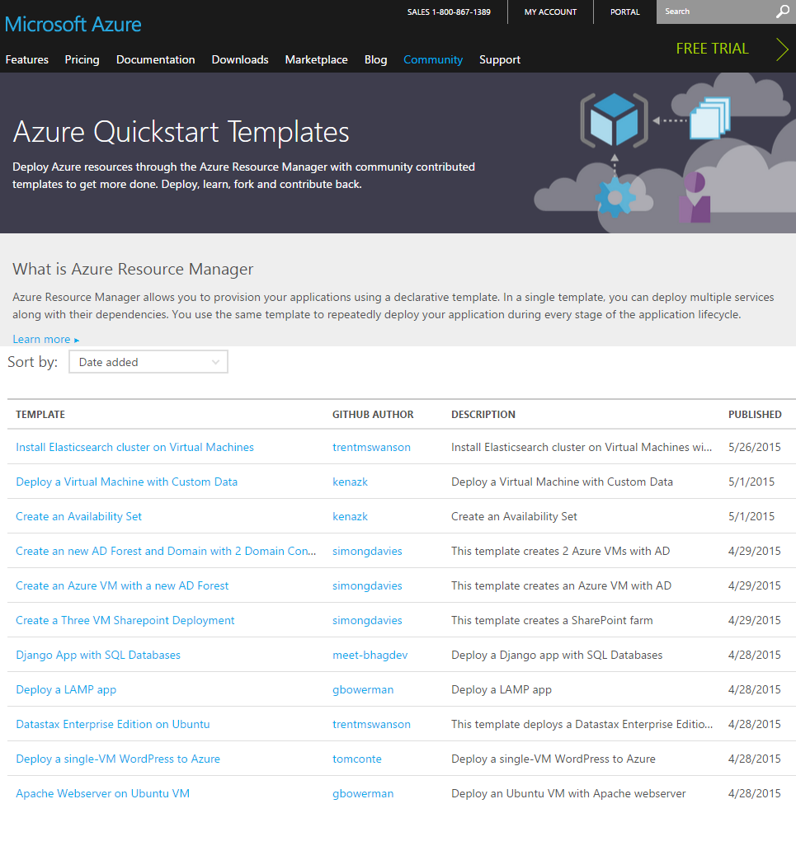
Getting started with Azure templates
  Wide range of Quickstart templates
    Indexed on Azure.com
    GitHub repo
    Community and Microsoft contributed
  Integration of IaaS with Azure Services
Many examples available @ https://github.com/Azure/azure-quickstart-templates
Notes:
Best practices for designing Azure Resource Manager templates
https://azure.microsoft.com/en-us/documentation/articles/best-practices-resource-manager-design-templates/
Also, see Appendix for additional slides on this topic

Slide 65
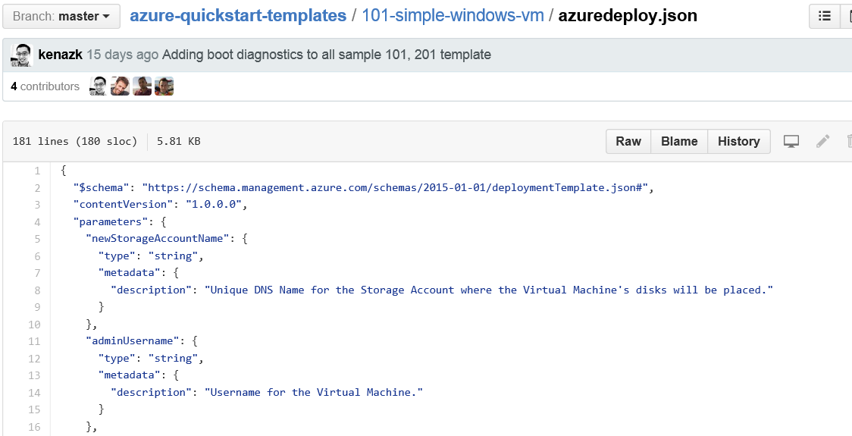
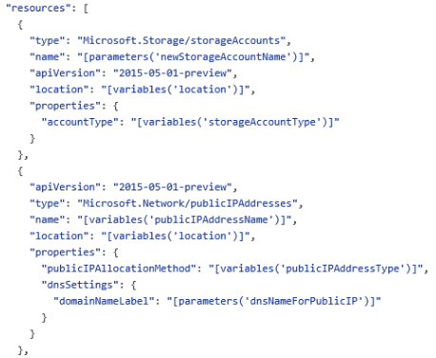
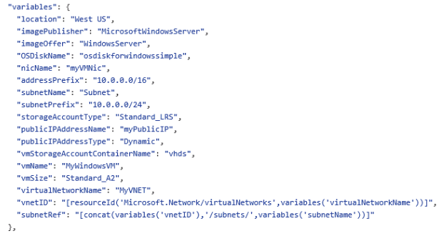
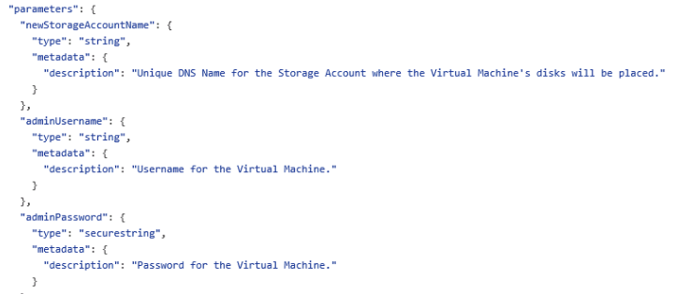
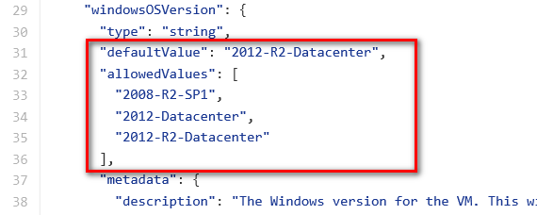
JSON files—simpler than they look
Schema, content version, parameters, variables, resources, and outputs
Notes:
A JSON template file is a text file that contains descriptions of the resources, configurations code and extensions. JSON templates are idempotent, which means that they can be run multiple times without changing the outcome beyond initial deployment. A consequence of this characteristic is that templates can be used to upgrade applications, for example, by scaling out applications with additional VMs. You modify the template to include the specifications for the additional virtual machines. When you deploy the template, Azure Resource Manager will recognize the resources that have previously been deployed and create only the resources that have been added.
A JSON template is divided into sections:
<CLICK> The $schema (a required element that provides the location of the file that describes the version of the template language) along with a required element that provides the version of the template
The schema reference is used by intelligent JSON clients to determine the schema that is applicable to the JSON file and to provide additional functionality such as autocomplete and intellisense.
<CLICK> Parameters (optional elements that define values that are passed in when the template is executed)
The value for the Parameters key is an array of parameter objects that representing the dynamic input for the JSON template. Each of the parameter objects has a name that is used pass values in at runtime and is referenced within the JSON itself in other sections. For example, "NewStorageAccount" is the name of the parameter that is supplied as an input and used to provide the name of the storage account resource specified in the JSON file.
<CLICK> Variables (optional elements that define the values that are used when template is executed)
<CLICK> Resources (a required element that defines the resources that are deployed or updated in a resource group); and
This slide doesn’t show it, but you can also have an optional Outputs section that defines values that are returned after a deployment
<CLICK> A JSON file is constructed of key/value pairs. For example, in the image above, "ContentVersion" is the key and "1.0.0.0" is the value. A key is always a string enclosed in quotation marks. A value can be a string, securestring, number, boolean expression, array, or object. A JSON object is enclosed in curly braces, "{ }". In a key/value pair the key is always followed by a colon. Key/pairs are separated by commas.
A JSON template may also contain functions and expressions. Expression are enclosed in square brackets, "[ ]', and can appear anywhere in a JSON string. Functions calls have the format functionName(arg1,arg2,arg3). Properties are referenced using the dot and index operators.
The lab provides notes with additional details regarding specific parameters, variables, resources, etc.
Authoring Azure Resource Manager templates
https://azure.microsoft.com/en-us/documentation/articles/resource-group-authoring-templates/

Slide 66
Passing state—common parameters
Name (string values) | Description
Location | The location where the resources will be deployed from a constrained list of Azure regions
storageAccountNamePrefix | Unique DNS name for the storage account where the VM’s disks will be placed
virtualNetworkName | For deployments that create a new virtual network, the name to use for creating that resource. For deployments that use an existing virtual network, the name of the VNet to deploy into
username | User name for the virtual machine(s) and potentially the application(s). More than one user name can be requested from the end user, but at least one must be prompted
password | Password for the virtual machine(s) and potentially the application(s). More than one password can be requested from the end user for different VMs or applications, but at least one must be prompted
tshirtSize | The named scale unit size to provision from a constrained list of offered t-shirt sizes For example, “Small”, “Medium”, “Large”
enableJumpbox | Parameter that identifies whether to enable a jumpbox for the environment Values: “enabled”, “disabled”

Slide 67
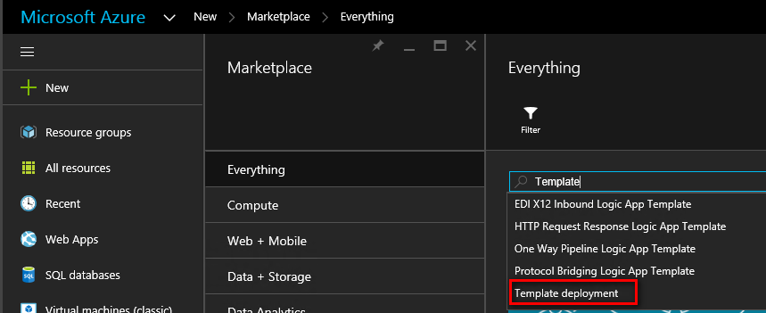
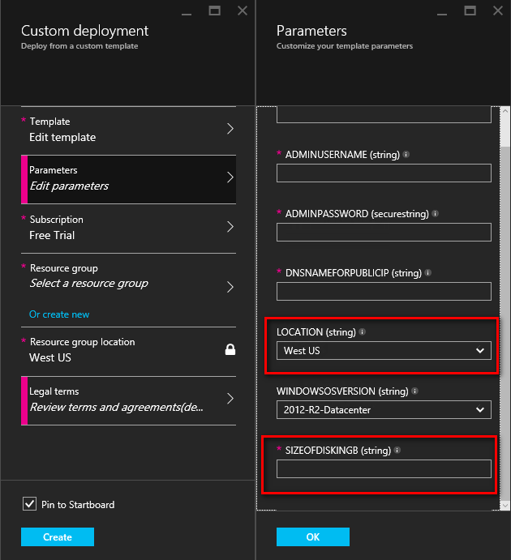
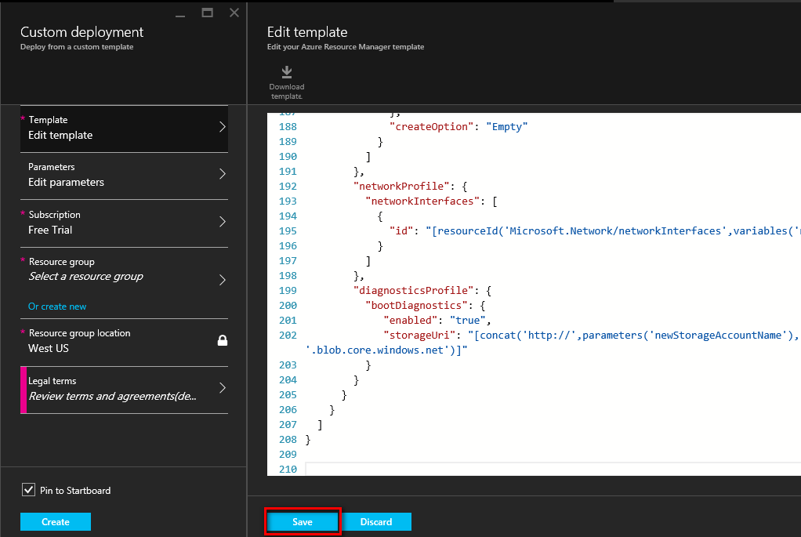
Deploying custom JSON files
New-AzureResourceGroupDeployment -DeploymentName "Simple-VM" -ResourceGroupName
RG-AZITCAMP -TemplateFile "C:\GitHub\Templates\101-simple-windows-vm\azuredeploy.json
Notes:
The Lab walks through this process from start to finish
Deploy an application with Azure Resource Manager template
https://azure.microsoft.com/en-us/documentation/articles/resource-group-template-deploy/

Slide 68
Tools to help manage templates
GitHub
Visual Studio Code
NotePad/NotePad++
Notes:
This is a placeholder slide to allow for an explanation of why Git/Github/VSCode are being discussed in this session.

Slide 69
GIT
A widely used version control system for software development
A distributed revision control system with an emphasis on speed, data integrity, and support for distributed, non-linear workflows
A full-fledged repository with complete history and full version-tracking capabilities, independent of network access or a central server
Notes:
https://en.wikipedia.org/wiki/Git_(software)

Slide 70
GitHub
https://github.com
The largest code host on the planet with over 27.6 million repositories
Every repository comes with the same
powerful tools
Tools are open to the community for public
projects and secure for private projects
Allows for creation of a GIT Desktop and
cloned repository

Slide 71
Visual Studio Code integration with GIT
Open your team repository in Visual Studio
Clone your repository
Create a new app
Confirm your settings and add the app
Snapshot (commit) your code
Pull changes from your team
Push your local commits to the server
Notes:
Develop and share your code in Git using Visual Studio
https://www.visualstudio.com/en-us/get-started/code/share-your-code-in-git-vs

Slide 72
Optional Lab
Deployment with ARM Templates and GIT
Notes:
For this lab, you should be working from the ITI –Azure Infrastructure, specifically Lab 1, Deployment with ARM templates and GIT

Slide 73
Azure infrastructure
Prepare the Azure infrastructure
  AZCampStart.ps1
Understand Azure templates and resource groups
  Understand Azure Quickstart templates
  Review a template from GitHub

Slide 74
Configure GIT repositories and Visual Studio Code
Create GitHub account and public repository
Configure GitHub desktop and clone repository
Examine Visual Studio Code integration with GIT and push commits to remote repository

Slide 75
Modify and deploy
Azure QuickStart templates
  Modify sample template and parameter JSON files
  Deploy custom JSON files
Reset the Azure environment
  Remove resource groups from Azure environment
.\RGCleanup.ps1

Slide 76
Resources

Slide 77
Resources
Register for another IT Innovation Series event
Further topics: Windows Server 2016, Windows 10 and more.
aka.ms/ITInnovation
Continue your learning
Download this presentation, access online training and demos, try Azure for free.
aka.ms/ITInnovationResources
Know someone who wants to learn more about
the Cloud?
Tell them to get started at the Microsoft Cloud Roadshow.
www.microsoftcloudroadshow.com

Slide 79
Appendix (X)
Azure Resource Manager

Slide 80
Template language expressions
base64encode(‘stringtoencode’)
concat(‘string’,’to’,’encode’)
copyIndex(offset)
listKeys(storageAccountResourceId, apiVersion)
padLeft(stringToPad,targetLength,paddingCharacter)
parameters(‘parameterName’)
providers(namespace, resourceType)
reference(resourceId,apiVersion)
resourceGroup()
resourceId(‘namespace/resourceType', ‘resourceName’)
subscription()
variables(‘variables’)

Slide 81
Passing state in and out of templates
Multiple types of state
  Parameters
  Static variables
  Dynamic variables
Templates accept parameters
Templates return variables as output values
Simple or complex object types are supported

Slide 82
Passing state—complex objects
  Easier to pass a number of related values with a single variable
  Object.Property approach provides additional context when reading the template
Examples
"networkSettings": {
"vnetName": "[parameters('virtualNetworkName')]",
"addressPrefix": "10.0.0.0/16",
"subnets": {
"dmz": {
"name": "dmz",
"prefix": "10.0.0.0/24",
"vnet": "[parameters('virtualNetworkName')]"
},
"data": {
"name": "data",
"prefix": "10.0.1.0/24",
"vnet": "[parameters('virtualNetworkName')]"
}
}
}
"osSettings": {
"imageReference": {
"publisher": "Canonical",
"offer": "UbuntuServer",
"sku": "14.04.2-LTS",
"version": "latest"
}
"tshirtSizeSmall": {
"vmSize": "Standard_A1",
"diskSize": 1023,
"vmTemplate": "[concat(variables('templateBaseUrl'), 'database-2disk-resources.json')]",
"vmCount": 2,
"storage": {
"name": "[parameters('storageAccountNamePrefix')]",
"count": 1,
"pool": "db",
"map": [0,0],
"jumpbox": 0
}
},
"availabilitySetSettings": {
"name": "pgsqlAvailabilitySet",
"fdCount": 3,
"udCount": 5
}

Slide 83
Passing state—output variables
A template can return values to its caller via the outputs section
These values can then be used by the caller
"outputs": {
"masterip": {
"value":
"[reference(concat(variables('nicName'),0)).ipConfigurations[0].properties.privateIPAddress]",
"type":"string"
}}
"masterIpAddress": {
"value":
"[reference('master-node').outputs.masterip.value]"
} }

Slide 84
Control flow
No control flow logic built into ARM template language
An approach with parameters, variables, and linked templates
  Use provides parameter value that provides context, e.g., tshirtSize parameter is passed in as a value of ‘small’
  Using concat and a pre-defined variable, a new variable value is created which points to the specific , e.g., ‘tshirtSize-small.json’
  Template linking is incorporated into the template and uses this new value to identify which template to deploy.
  Common examples are “tshirt sizes” and optional features for a deployment, e.g., “enableJumpbox”

