Slide 1
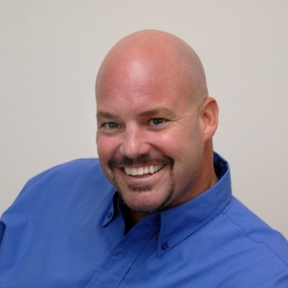
Yung
Chou
Blain
Barton
Sr.
IT Pro Evangelist
Microsoft
Virtualization
System Center
http://aka.ms/blainbarton
@blainbar
FL, MS

Slide 2
Wireless
Wireless Info
Network: MSFTGUEST
Username: usmsguest
Password: Xp6d8988
…
http://aka.ms/MSevals

Slide 3

Yung
Chou
Sr.
IT Pro Evangelist
Microsoft
Private Cloud
Virtualization
Private Cloud
http://aka.ms/yungchou
http://aka.ms/yc
@yungchou
DC, MD, VA, WV, NC, SC, GA, AL

Slide 4

Bob
Hunt
Blain
Barton
Sr.
IT Pro Evangelist
Microsoft
Collaboration
Unified Comm.
http://www.bobhunt.net
@bobhms
NYC Metro, PA, DE

Slide 5

Sr.
IT Pro Evangelist
Microsoft
Dan Stolts
Virtualization
Cloud
System Center
http://ITProGuru.com
http://blogs.technet.com/DanStolts
@itproguru
????

Slide 6
Emergency Exit, Rest Room, Cell
Change of Event Format
Continual Partnership
9 - Yeah, I learned Hyper-V
8 - Cool event
7 - Here are the action items to improve
6 – This is not good
…
Logistics
Score generously, constructive feedback

Slide 7
Agenda
09:00 AM - Welcome
09:00 AM – Hyper-V Readiness
10:15 AM – Hyper-V Essentials – Hands On Labs
10:50 AM – Break
Noon– Lunch
12:45 PM – Leverage Public Cloud & Office 365
02:00 PM – Break
02:15 PM – Drive Costs Down with Systems Management
03:30 PM – Q&A
03:45 PM – Closing and Raffle

Slide 8
Download Process Walkthrough
System Center 2012 - Please choose this for download to get credit
Windows Server 8
Windows Server 2008 R2 SP1 http://aka.ms/msevals
Hyper-V Server 2008 R2
1.
Go to Download Link
2.
See the Download page
3.
Enter or Establish your Live ID
4.
Download Manager
Begins – then cancel for Credit

Slide 9
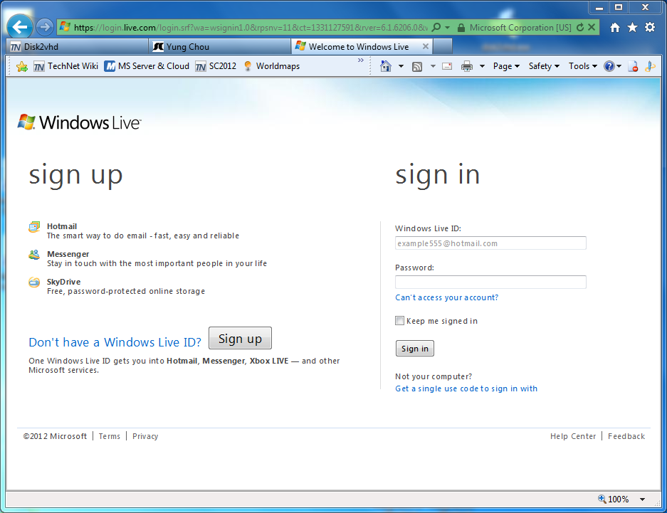
Demo – Entering Live ID

Slide 10
Check the BIOS
Boot Computer
F1, F2, F10?
Check to see if Virtualization is “Turned On” under Processor
Enable “Execute Disable” under Security

Slide 11
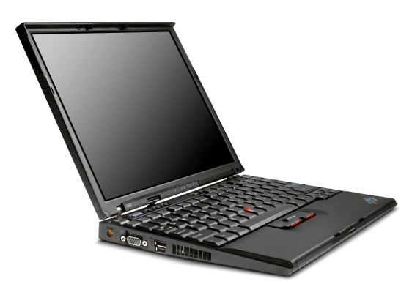
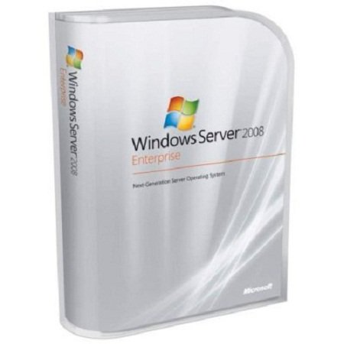
Hyper-V Readiness
X64 Hardware-Assisted Virtualization
AMD Virtualization (AMD-V)
Intel Virtualization Technology (Intel VT)
4 GB+ RAM
Windows Server 2008 R1 SP1
http://aka.ms/MSevals
Hyper-V Role in Server Manager
One checkbox followed two reboots
Notes:
Hyper-V runs on a x64 server platform and requires support of either AMD64 or Intel x64 processors with hardware-assisted virtualization support. Hyper-V does not support Itanium (IA-64) processors. For the virtual machines, Hyper-V supports both x32 and x64 systems as guest operating systems.
Your system may require an update to the latest available BIOS version for your server hardware.
It is best to enable this in the BIOS before configuring the system.

Slide 12
Tweeter Hash Tag: #msitcamp
Direct Feedback to Microsoft
dpeermka@microsoft.com

Slide 13
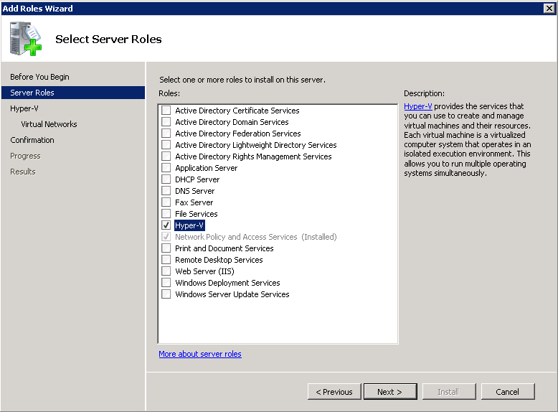
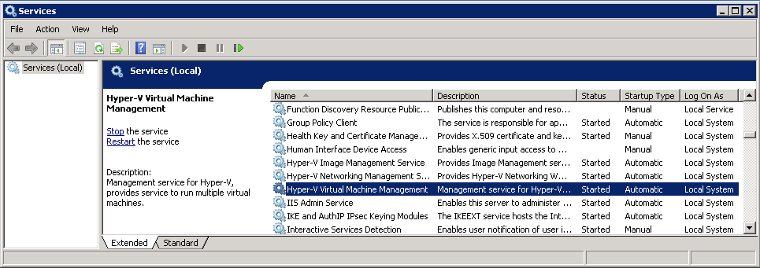
Hyper-V Role
One checkbox followed by two reboots
Notes:
You must install and start the hypervisor before you can start any virtual machine.
The Hyper-V Virtual Machine Management Service must be running to manage virtual machines. You can verify the status of the Hyper-V Virtual Machine Management Service by using the Services snap-in located in Administrative Tools. Two additional services are also started including the Hyper-V Image Management Service and the Hyper-V Networking Management Service.

Slide 14
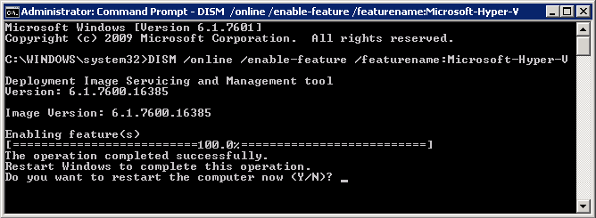
Enabling by CLI (Server Core)
CMD
  > DISM /online /enable-feature /featurename:Microsoft-Hyper-V
  > start /w ocsetup Microsoft-Hyper-V
PowerShell
  > Add-WindowsFeature Hyper-V
Server Manager GUI available with remote management
Notes:
There are (at least) 3 different ways to enable Hyper-V programmatically.
http://technet.microsoft.com/en-us/library/cc794852(WS.10).aspx

Slide 15
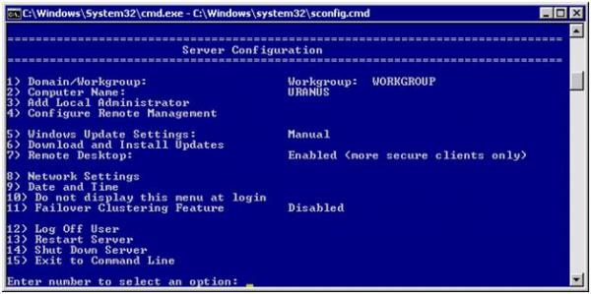
Hyper-V 2008 R2 Server
Hyper-V enabled automatically!
Notes:
Since Hyper-V server only supports the Hyper-V role, it is enabled automatically

Slide 16
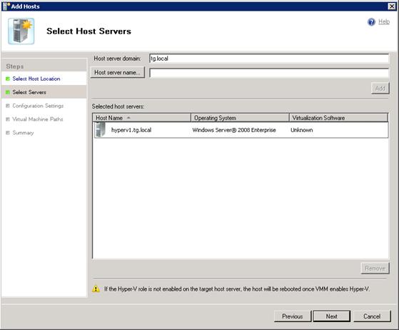
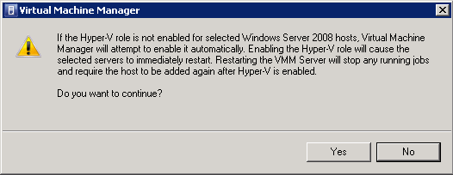
Enabling by SCVMM
Automatically enabled when adding hosts
Notes:
VMM requires Hyper-V to be installed, so it will automatically install the role.
The notification will still appear even if Hyper-V is already installed – this can be confusing to some users.
If you are add the VMM Server you are using as a host, and it does not have Hyper-V, the host you are using will reboot. Hyper-V is not required to be installed for just managing the VMM Server.

Slide 17
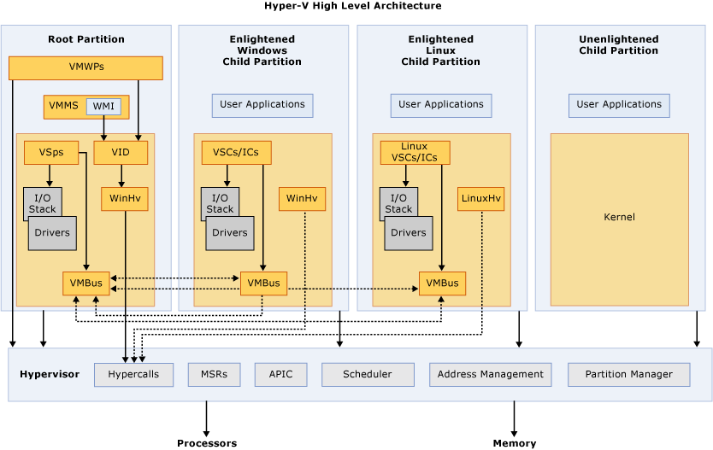
Hyper-V Architecture
Notes:
http://msdn.microsoft.com/en-us/library/dd722833(v=BTS.10).aspx
APIC – Advanced Programmable Interrupt Controller. A device which allows priority levels to be assigned to its interrupt outputs.
Child Partition – Partition that hosts a guest operating system. All access to physical memory and devices by a child partition is provided via the Virtual Machine Bus (VMBus) or the hypervisor.
Hypercall – Interface for communication with the hypervisor. The hypercall interface accommodates access to the optimizations provided by the hypervisor.
Hypervisor – A layer of software that sits between the hardware and one or more operating systems. Its primary job is to provide isolated execution environments called partitions. The hypervisor controls and arbitrates access to the underlying hardware.
IC – Integration component. Component that allows child partitions to communication with other partitions and the hypervisor.
I/O stack – Input/output stack.
MSR – Memory Service Routine.
Root Partition – Manages machine-level functions such as device drivers, power management, and device hot addition/removal. The root (or parent) partition is the only partition that has direct access to physical memory and devices.
VID – Virtualization Infrastructure Driver. Provides partition management services, virtual processor management services, and memory management services for partitions.
VMBus – Channel-based communication mechanism used for inter-partition communication and device enumeration on systems with multiple active virtualized partitions. The VMBus is installed with Hyper-V Integration Services.
VMMS – Virtual Machine Management Service. Responsible for managing the state of all virtual machines in child partitions.
VMWP – Virtual Machine Worker Process. A user mode component of the virtualization stack. The worker process provides virtual machine management services from the Windows Server 2008 instance in the parent partition to the guest operating systems in the child partitions. The Virtual Machine Management Service spawns a separate worker process for each running virtual machine.
VSC – Virtualization Service Client. A synthetic device instance that resides in a child partition. VSCs utilize hardware resources that are provided by Virtualization Service Providers (VSPs) in the parent partition. They communicate with the corresponding VSPs in the parent partition over the VMBus to satisfy a child partitions device I/O requests.
VSP – Virtualization Service Provider. Resides in the root partition and provide synthetic device support to child partitions over the Virtual Machine Bus (VMBus).
WinHv – Windows Hypervisor Interface Library. WinHv is essentially a bridge between a partitioned operating system’s drivers and the hypervisor which allows drivers to call the hypervisor using standard Windows calling conventions
WMI – The Virtual Machine Management Service exposes a set of Windows Management Instrumentation (WMI)-based APIs for managing and controlling virtual machines.

Slide 18
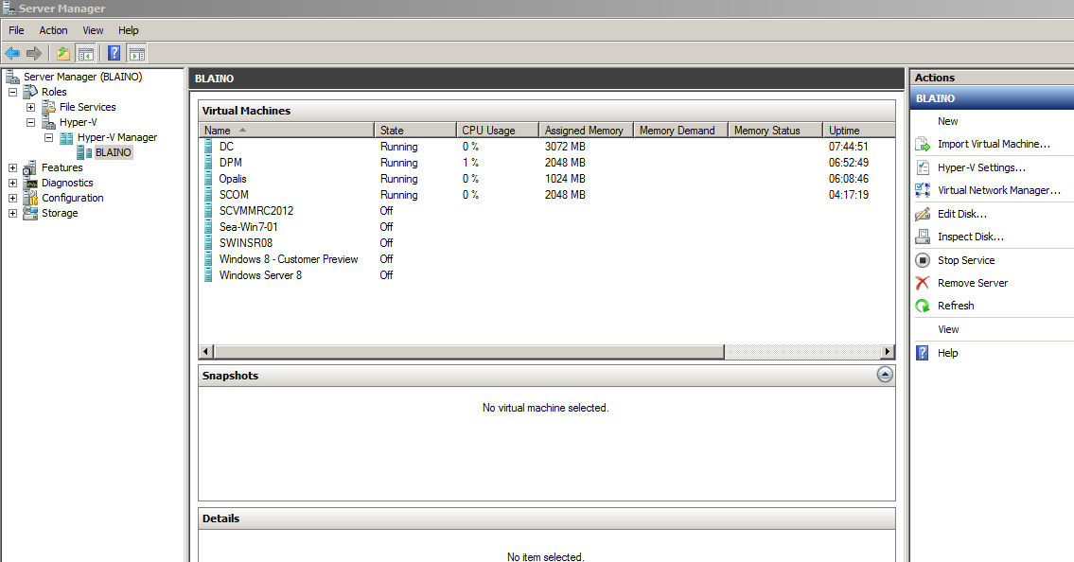
Hyper-V Manager
Notes:
Cover each of the panes, their purpose, and what is found in each location.
18

Slide 19
Virtualization Host SKU
Hyper-V Server
2008 R2
Free Host OS with Server Core only
Guest OS license
Download - http://aka.ms/MSevals
Windows Server
2008 R2 SP1
Enterprise
Licensed per server
4 Guest OS licenses per server
Download - http://aka.ms/MSevals
Windows Server
2008 R2 SP1
Data Center
Licensed per CPU
Unlimited Guest OS licenses
Download - http://aka.ms/MSevals
Notes:
As we go and plan our host sku there are really three different choices that should be the primary consideration. The check – the differences between each of these are the number of guest licenses, how the actual servers are licensed and the management options that you have. You may notice that Windows Server 2008 R2 standard and web edition are not listed here. The reason for this is that these servers do not support clustering and high availability is a critical component of every private cloud implementation. First let’s take a look at the hyper-v server. We’re going to cover this in a little more details as far as some of the advanced feature set, but with hyper-v server it is essentially a free and stripped down operating system. You can actually go and download it today purely to use as a virtualization host. The reason why it’s not branded Windows Server is because it does not include all of the additional server roles and features that a traditional Windows Server would have such as Active Directory, DHCP, etc. Hyper-v server purely focuses on hyper-v. For this reason, when you go get the server, since it is free, it does not include any licenses for any VMs that are running. So if you’re going to go and run Windows client in that VM you still need to license it, however, you could certainly use any types of free licenses, volume licenses or open source software inside that guest OS. Windows Server 2008 R2 Enterprise Edition comes with a license for the host and also for licenses for the guest VMs. So you essentially get five licenses in one. However, if you’re thinking private cloud you really don’t want to be restricted by any type of licensing consideration. So we recommend going for Windows Server 2008 R2 Data Center Edition. With Data Center Edition you get the license of the host and you get unlimited licenses for VMs. This means that you have a lot more flexibility with dynamically provisioning, scaling out or even just having elasticity in your environment. You no longer need to worry about mapping guest licenses to VMs, as you have an unlimited number. As we look at the actual host OS, as we know, Hyper-V Server is free. Windows Server Enterprise Edition is licensed at the server level and Data Center Edition at the CPU level. As we look at management, Hyper-V Server can be managed directly only by Windows Server Core. And what this means is that there is no graphical user interface directly on Hyper-V Server. Having said that, you still have the ability to remotely connect to the Hyper-V Server and manage it with a full GUID using remote server administrator tools, managing from another server using server manager, or even using System Center Virtual Machine Manager. Of course Enterprise Edition and Data Center Edition include both a full installation or the option to use just Server Core.

Slide 20
Guest OS Support
Windows Server
Windows Server 2000
Windows Server 2003
Windows Server 2008
Windows Server 2008 R2
Windows Client
Windows XP Pro SP2/SP3
Windows Vista
Windows 7
Non-Microsoft
SUSE Linux Enterprise Server 10/11
RHEL 5.2/5.3
CentOS
  Full list: http://technet.microsoft.com/en-us/library/cc794868(WS.10).aspx
Notes:
SUSE Linux Enterprise Server (SLES) is a Linux distribution supplied by Novell and targeted at the business market.
Red Hat Enterprise Linux (RHEL) is a Linux distribution produced by Red Hat and targeted toward the commercial market, including mainframes
CentOS

Slide 21

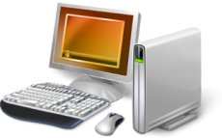
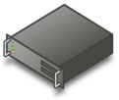
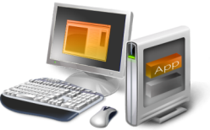
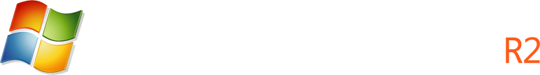



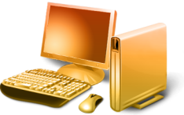

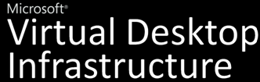


Microsoft Virtualization
Server
Virtualization
Application
Virtualization
Presentation
Virtualization
Desktop
Virtualization
User State
Virtualization
Roaming Profiles
Folder Redirection
Notes:
The concept and options for virtualization has developed rapidly in the last few years. Spend some time with this topic, and define virtualization. Stress that it essentially just separates the traditional connection between operating systems, applications, and data from a single hardware instance. Then provide a high-level overview of the different options for enabling virtualization. This module covers each of these virtualization options in more detail, so do not spend a lot of time on each option now.
Mention that central role that Microsoft System Center tools provide in managing the virtual environment. Deploying virtualization may appear to increase the complexity of the information technology (IT) infrastructure, so stress that the System Center tools provides a variety of tools to manage both the physical and the virtual environments.
Resources
Selecting the Right Virtualization Technology
http://go.microsoft.com/fwlink/?LinkId=189053

Slide 22
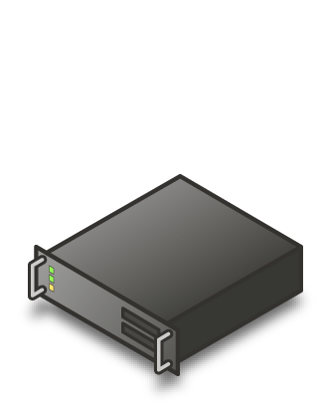
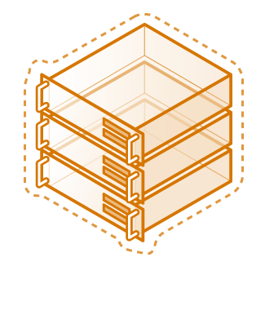




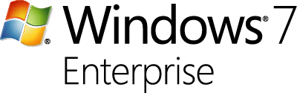
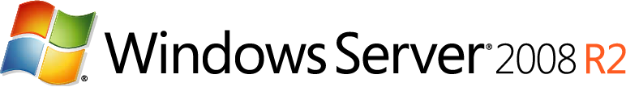
Applications are Key
Microsoft fully supports our
key server applications in
a virtualized environment
Microsoft has updated server workload licensing to enable virtualization mobility
Management of the workloads is key, not just the virtual machine
Support list KB 957006
Notes:
Microsoft management considers not just the VMs, but also the applications running in the VM.
System Center protects and monitors applications, as well as VMs and the physical infrastructure.
All Microsoft enterprise products are thoroughly tested while running in Hyper-V VMs. Review the KB article for a complete list.

Slide 23
Virtual Machine Components
Memory
Compute
Network
Storage
Notes:
Consider opening Hyper-V Manager and briefly describing the configuration components in a Hyper-V virtual machine. The next two modules cover these configuration options in more detail, but if students have not seen these options before, a short demonstration will help them to visualize them.
As you discuss the different operating system options for virtual machines, emphasize that the configuration options in Hyper-V change depending on the guest operating system. Also considering showing how the amount of random access memory (RAM) or the number of processors that you can assign to a virtual machine are dependent on the host computer’s physical hardware.
Mention that although you can run virtual machines running Windows Server 2000 SP4, and Windows Server 2003 SP2 in Hyper-V virtual machines, the students should be aware that these products are already at or close to the end of the product support cycle from Microsoft. This may mean that Microsoft will not support these operating systems whether deployed on virtual machines or physical servers.
Resources
About Virtual Machines and Guest Operating Systems
http://go.microsoft.com/fwlink/?LinkId=189066
23

Slide 24
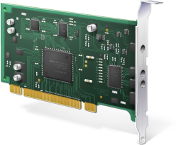
Virtual Network Adapter
Synthetic
Not for PXE boot
High performance
Legacy
PXE bot support
Emulated
Notes:
Emulated network adapter
Emulated network adapters are available on all of the virtualization software platforms and allow virtual machines to be connected to virtual networks. Virtual networks can be connected to other virtual machine network adapters and to host network interface cards.
Emulated devices are the hardware that is presented inside of the virtual machine. If you have used Virtual Server / Virtual PC you will be quite familiar with this hardware. It includes things like a Intel 440bx motherboard and an Intel 21140 network adapter. These devices are handled through emulation that runs in the parent partition. The advantage of emulated devices is that most operating systems have in-box drivers for them and are able to install and boot using them. The disadvantage of emulated devices is that because they were not designed with virtualization in mind they do not perform well.
Synthetic network adapter
Synthetic devices are new with Hyper-V and provide better performance than emulated network adapters. Synthetic network adapters require Virtual Guest Services (VGS) to be installed on the virtual machine. VMM installs VGS for all supported guest operating systems.
Synthetic devices are the new high performance devices that are available with Hyper-V. Here, rather than emulating an existing hardware device we expose a new hardware device that has been designed for optimal performance in a virtualized environment (I will not go into a performance discussion of synthetic versus emulated devices here - as that is quite a lengthy discussion and can wait for another day). Generally speaking you will never see reference to a "synthetic" or "emulated" device in our user interface as we have tried to hide this from the user as much as possible.
Most of our devices (IDE, video, mouse, etc...) support booting in emulated mode, but then switching across to synthetic mode once appropriate drivers are loaded. There are some exceptions to this though. On networking you have to choose to use a "Network Adapter" or a "Legacy Network Adapter". The former is a synthetic device while the latter is an emulated device. With storage the "SCSI controller" only exists as a synthetic device. And finally there are a handful of devices where performance is not really a problem (like COM ports) so we only offer emulated devices for them.

Slide 25
Virtual Networks
External
Communicate with other computers on the network
Internal
Communicate with the host computer and only other VMs on the same host,
Private
Communicate only with other VMs on the same host
Notes:
You can configure three types of networks by using the Virtual Network Manager Tool:
External: This network binds to a physical network adapter on the Hyper-V server, so that the virtual machine can access a physical network or can be accessed from within the corporate network or outside the corporate network
Internal: This network is for use by the virtual machines that are running on the Hyper-V Server. Virtual machines on this network can communicate with each other and with the parent partition, but not external to the physical machine. Can be used for a training environment or to simulate a network.
Private: Only virtual machines can use this network. There is no association with any physical network adapter in the parent partition. Used when the virtual machines will never access or be accessed by either the base system or beyond. Great for secure segments and R&D.

Slide 26
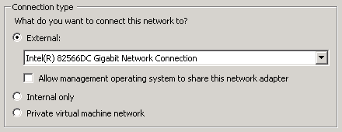
Configure Virtual Networks
Create a New Internal Virtual Network
Modify an Existing External Virtual Network

Slide 27
Virtual Hard Disk (VHD)
Fixed
Storage allocated at creation time
Best performance for production use
Dynamic
Size grows as data are brought in
Small footprint and great for test/dev
Differencing
Linked to a read-only parent disk as
  a base image
Store only the delta
Notes:
When converting a dynamic disk to a fixed disk, it becomes the same size as the maximum size for the dynamically expanding disk. This could be an issue if you create a large maximum size for the dynamically expanding disk, and then want to convert it to a fixed size disk.
If you move the parent disk, you can reconnect the differencing disk by inspecting it. If Hyper-V cannot locate the parent disk, you have the option to reconnect the differencing disk to the parent in its new location.
Bus - The IDE or SCSI bus to which to attach the disk. If you select <Auto>, the first available value will be selected.
Bus Type - IDE or SCSI
File Name - The name of the VHD on which the new disk will be based. If you select <Auto>, the name will be generated based on the name of the virtual machine to which the disk will be added together with a unique identifier.
Logical Unit Number (LUN) - The logical unit number (LUN) for the VHD object on an IDE or SCSI bus. If you select <Auto>, the first available value will be selected.
Virtual Hard Disk Path - The location of the VHD used to create the disk
VM ID - The unique identifier (GUID) of the virtual machine to which the disk will be added
Dynamically Expanding Disks
The size of this type virtual hard disk expands to a specified maximum size and does not automatically shrink when the data is deleted. Dynamically expanding disks offer the most efficient use of disk space, but incur a loss in performance when the hard disk has to expand to accommodate additional data. Dynamically expanding disks are best suited for test and development environments.
Fixed Size
This type virtual hard disk uses a fixed amount of space, regardless of the amount of data stored in it. Fixed size disks offer a greater storage cost, but do not suffer from a performance loss due to expansion. Fixed size disks are best suited for production virtual machines that require best possible performance.
When you create a fixed disk, you have the option to create a blank fixed size disk, or to copy the contents of an existing physical disk.
Dynamically Expanding Virtual Hard Disks
Dynamically expanding VHDs start off very small (just a few megabytes in size) and grow as data is written them. By default, Hyper-V creates dynamically-expanding virtual hard disks.
When you create a dynamically expanding virtual hard disk, you specify a maximum file size. The default maximum size is 127 gigabytes (GB), and they can be as large as 2 terabytes. The maximum size specified at creation restricts how large the virtual hard disk file size can grow. For example, if you create a 127 GB dynamically expanding virtual hard disk, the initial size of the .VHD file is about 3 megabytes (MB). As the virtual machine uses the virtual hard disk, the size of the .VHD file grows as data is written the VHD up to 127 GB. If you hit the limit, you can expand the size through the Hyper-V Disk Wizard.
Dynamic VHD Benefits
Efficient: Dynamically expanding virtual hard disks grow dynamically as the virtual machine needs more storage. Great for portability.
Dynamic VHD Drawbacks
Deferred storage allocation: Suppose you create 10 virtual machines with a maximum size of 100 GB each, and you place these on a 500-GB disk. These 10 virtual machines may all fit within 500 GB when you create them. However, over time, as those disks grow, it is possible that they outgrow storage because the disk resources are not allocated upfront.
Fragmentation and possibly slight performance impact: Because dynamically-expanding virtual hard disks grow only when needed, they tend to fragment easily. In addition, when the virtual hard disks grow, NTFS file system automatically zeros the new allocation (for security), which has a very small performance overhead.
Dynamic VHD Use Scenario
Dynamically expanding virtual hard disks are ideal for use in test and development environments, where performance is not always a factor.
Differencing disks store all state changes to a virtual machine or virtual hard disk in a separate file. This allows you to isolate changes to a virtual machine and keep a virtual hard disk in an unchanged state.
Virtual Server 2005 and Virtual PC 2007 use another disk type, called an undo disk. The main difference between an undo disk and a differencing disk is that undo disks apply to all virtual hard disks associated with a virtual machine, and a differencing disk applies to one virtual hard disk only. Windows Server® 2008 R2 Hyper-V does not include the undo disk type, but does introduce a new feature called a snapshot. A snapshot allows you to take a point-in-time snapshot of a virtual machine. All virtual machine state information is saved. At any time, you can revert the virtual machine back to that specific point in time.

Slide 28
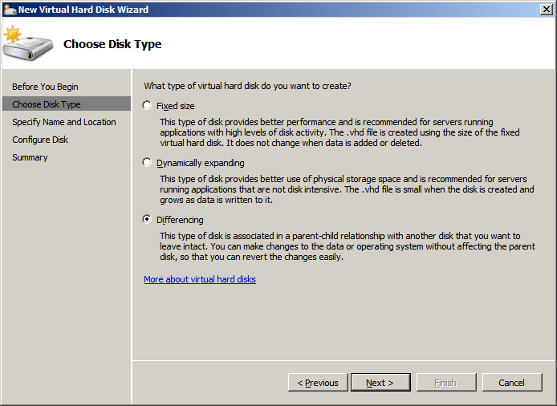
Create VHD’s with the New Virtual Hard Disk Wizard
Fixed
Dynamically
Differencing
Notes:
When converting a dynamic disk to a fixed disk, it becomes the same size as the maximum size for the dynamically expanding disk. This could be an issue if you create a large maximum size for the dynamically expanding disk, and then want to convert it to a fixed size disk.
If you move the parent disk, you can reconnect the differencing disk by inspecting it. If Hyper-V cannot locate the parent disk, you have the option to reconnect the differencing disk to the parent in its new location.
Bus - The IDE or SCSI bus to which to attach the disk. If you select <Auto>, the first available value will be selected.
Bus Type - IDE or SCSI
File Name - The name of the VHD on which the new disk will be based. If you select <Auto>, the name will be generated based on the name of the virtual machine to which the disk will be added together with a unique identifier.
Logical Unit Number (LUN) - The logical unit number (LUN) for the VHD object on an IDE or SCSI bus. If you select <Auto>, the first available value will be selected.
Virtual Hard Disk Path - The location of the VHD used to create the disk
VM ID - The unique identifier (GUID) of the virtual machine to which the disk will be added

Slide 29
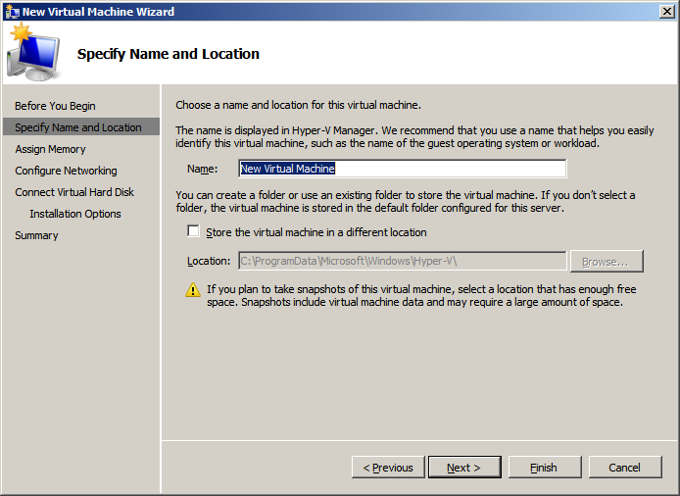
Deploy a New VM
Create a New VM
Name
Location
Memory
Network
Virtual Hard Disk
Operating System
Notes:
This is a great place to show the wizard as a simple demo.
Remember that any options can be changed later from the Hyper-V Settings window.

Slide 30
Virtual Machine Operations
Export
Saves snapshots, VHDs, VMs, config XML
Import
Move/Co
Move/Copy/Duplicate
Snapshot
Also known as checkpoint
Backup/Restore
Backup service provider
Migration
One-way process from Virtual Server 2005 R2
Notes:
There are various mechanisms to move to a R2 host.
Export / Import is generally the most common.
Export / Import
Export VMs that are not running
Saves snapshots, VHDs, VMs, config XML
Import VMs
Move VM (keeps same unique ID)
Copy VM (creates new unique ID)
Duplicate VM (allows for multiple new VMs)
Backup / Restore
Varies based on backup provider
Migration
Server Migration Tools
Migration from Virtual Server 2005 R2 is a unique one-way process

Slide 31

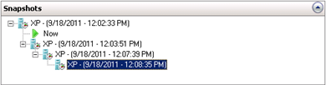
Hyper-V VM Snapshots
Snapshots
Snapshot files
A point-in-time copy of a virtual machine
Do not affect the running state of a virtual machine
Snapshot any guest OS
VM can be running, off, stopped or saved, but not paused
In VMM, snapshots are called “checkpoints”
VM configuration .XML file (*.xml)
Save state files (*.vsv)
VM memory contents (*.bin)
Snapshot differencing disk (*.avhd)
Notes:
Snapshots are a new feature of Windows Server 2008 Hyper-V. Snapshots are a point-in-time version of a virtual machine. This means that when the virtual machine is running, you can create a snapshot. At any time, you can select the snapshot, and revert the virtual machine back to that point in time. When a VM is restored using a snapshot, the virtual machine is in the exact configuration that it was when the snapshot was created (memory, virtual hardware, processes, and machine state).
Snapshots do not affect the running state of the virtual machine. When you create a snapshot, it does not change the virtual machine hardware, applications, or the processes that are running. Additionally, when deleting a snapshot, the virtual machine does not change, and the point-in-time save point is no longer restorable.
The snapshot files consist of the following:
A copy of the virtual machine configuration .xml file
Any save state files
A differencing disk (.avhd) that is the new working disk for all writes that is the child of the working disk prior to the snapshot.

Slide 32
VM Snapshot
A point-in-time copy
Not affect the running state o
Snapshot any guest OS
VM not paused
Also called “checkpoints”
Snapshot files
VM configuration .XML file (*.xml)
Save state files (*.vsv)
VM memory contents (*.bin)
Snapshot differencing disk (*.avhd)
Text

Slide 33
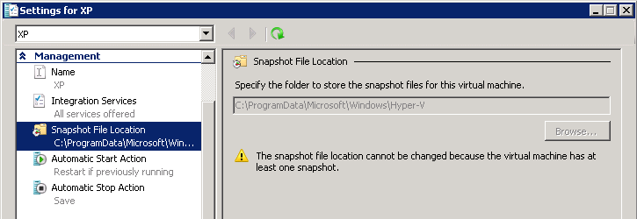
Snapshot Considerations
Should not be used in production environments
  No good for time-sensitive services (AD) or replication
Should be used in testing and training environments
May consume a significant amount of hard disk space
Can have unexpected results when deleted
Cannot be used with pass-through disks
Configure storage location
before taking first snapshot
Notes:
Emphasize that snapshots are fine for use in a lab or test environment, but not for use in a production environment. You should not use snapshots as a backup or recovery mechanism for Exchange or Active Directory® Domain Services (AD DS) or other transactional applications.
33

Slide 34
Backup & Restore Overview
VMs contain a single file (VHD) for the OS
  Easier to backup; Offline backup easy – just copy VM files to another location
  Cannot restore individual files
Consider online backups
  Install integration services (and backup integration service)
  Must use NTFS. FAT32 and dynamic disks not supported
  Enable Volume Shadow Copy Service (VSS) on all volumes the VM uses
Host backups
  Backup / restore all except virtual networks (incl. VM configuration, snapshots, VHDs
Guest backups
  Granular file / application level backup
  Use before, and in addition to full (host) backup
Notes:
Explain the backup types that you can perform with virtual machines on Hyper-V. The key point of this topic is to explain the benefits and drawbacks of each approach. Be sure to explain the terms online backups and offline backups. Emphasize that online backup is not always possible, and then discuss the requirements that must be met for online backup to succeed. The requirements are :
Integration services are installed
Disks inside the virtual machine that are formatted for NTFS file system, (dynamic volumes are supported only for offline backup)
Volume Shadow Copy Service must be enabled inside virtual machine
Emphasize the basic disk requirements for the NTFS file system, as this often is a reason why online backup does not work.
Choosing the appropriate backup method
For most organizations, a combination of host level backup and guest level backup will be the most appropriate solution. By using this approach, you will have very good options for complete disaster recovery (host level backups), while still keeping day-to-day recovery functionality (guest level backup). You should determine the frequency of each of these backup methods based how frequently data changes on both the host level and virtual machine level.

Slide 35
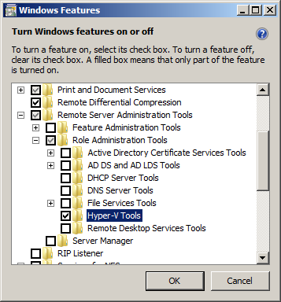
Remote Server Admin. Tools
RSAT allows server management on Client
Connect to Hosts
Free download:
http://www.microsoft.com/
download/en/details.aspx?
displaylang=en&id=7887
Must enable feature on Client
  Select Role Administration Tools
    Select Hyper-V Tools
Notes:
Ideal for Server Core or Hyper-V Server.
In order to configure the new Hyper-V Server 2008 R2 SP1 feature settings (RemoteFX, Dynamic Memory), make sure to use the the latest Windows 7 SP1 Remote Server Administration Tool(RSAT) for the client or use Windows Server 2008 R2 SP1

Slide 36
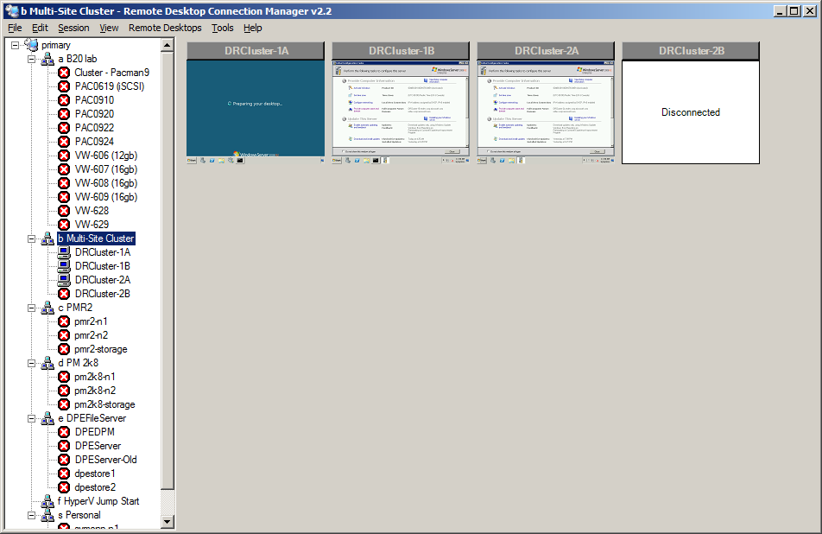
RD Connection Manager
Remote desktop connection management at scale
Connect to hosts or VMs
Runs on Server & Client
Free download:
http://www.microsoft.com/
download/en/details.aspx?
displaylang=en&id=21101
Notes:
Manage numerous VMs or Servers from a single interface
Free download

Slide 37
Active Directory
Common access across physical, virtual & Cloud from a single identity store
All physical servers must be members of the same forest
  Ideally in the same domain
Minimum of two domain controllers
  Bare metal recommended
  VMs are OK
    Be cautious putting DC in clustered
    VM as the cluster requires
    authentication to start the VM,
    but that may not be possible if the
    DC is not yet available
Security
Identity
Access
Management
  Common Platform & Infrastructure
Physical
Virtual
Client OS
Server OS
3rd Party
Notes:
Microsoft is delivering comprehensive, integrated solutions today across IT security, identity & access, and management to help customers save time, reduce costs, and protect their environment. This integrated approach applies across physical and virtual assets, and covers all aspects of virtualization –
Hardware virtualization: Where an operating system and an application are packaged together to form a virtual machine, which then runs on a physical device
Application virtualization: Enables app to run on a machine without installing it on the OS
Presentation virtualization: Enables app to run on one computer but be accessed through another
Our integrated approach starts with a common, secure infrastructure & platform. Windows Server 2008 deliver the most reliable, secure, and identity-aware Windows operating system to date. Our hardware virtualization solution– Hyper-V – is included in it. Windows Server 2008 also has many built-in security features such as Windows Server Core, Network Access Protection (NAP), Server and Domain Isolation (SDI), BitLocker Drive Encryption and others that enable us to provide layered protection for physical and virtual environments.
On top of this platform, we deliver integrated security, access, and systems management solutions through our Forefront and System Center product lines that enable customers to secure and manage their environments. At the core of this integrated approach is identity – with Active Directory, also part of Windows Server, providing the identity infrastructure for user identities, credentials and certifications across both physical and virtual IT assets.
Microsoft brings these unique capabilities together today – enabling customers through this integration to save time, reduce costs, and protect their physical and virtual IT environments.
Active Directory is a critical component of the private cloud deployment. It provides a common access across physical servers, virtual machines and even extends up to the cloud using a single identity store. Now using Active Directory we are going to have this as a requirement simply because it is going to ensure that the entire platform is secure. Remember, using Active Directory you can not just manage computers and servers, but you can manage how those users interact with the servers.

Slide 38
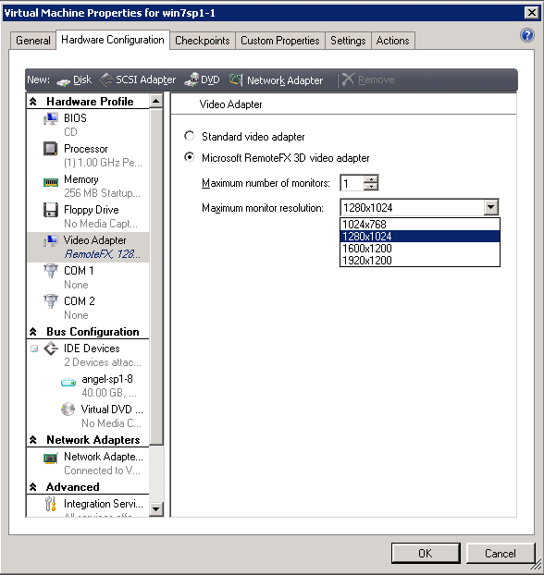
RemoteFX Support
New in Windows Server 2008 R2 SP1
3D GPU Host side Rendering
Improved Encode/Decode Pipeline
USB Redirection
  Enable RemoteFX on a VM
  Client must support RDP 7.1
  USB redirection must be enabled via GP
  GP update and reboot required
38
Notes:
Microsoft RemoteFX is a new feature that is included in Windows Server 2008 R2 with Service Pack 1 (SP1). It introduces a set of end-user experience enhancements for Remote Desktop Protocol (RDP) that enable a rich desktop environment within your corporate network.
What does RemoteFX do?
Microsoft® RemoteFX™ enables the delivery of a full Windows user experience to a range of client devices including rich clients, thin clients, and ultrathin clients. RemoteFX delivers a rich user experience for Virtual Desktop Infrastructure (VDI) by providing a 3D virtual adapter, intelligent codecs, and the ability to redirect USB devices in virtual machines. RemoteFX is integrated with the RDP protocol, which enables shared encryption, authentication, management, and device support. RemoteFX also delivers a rich user experience for session-based desktops and RemoteApp programs to a broad range of client devices.

Slide 39
Dynamic Memory
Hyper-V memory enhancement in Windows Server 2008 R2 SP1
Higher VM consolidation ratios on same hardware with minimal performance impact
Memory is pooled and dynamically distributed across VMs to allow it to easily grow or shrink with no service interruption
  Active Memory addition
    Memory is added immediately when VM needs it
  Passive Memory reclamation
    Unutilized memory is collected every 5 minutes
Supports both server and desktop
VM Guests are enlightened
  Guest Integration Components installed
  Must be updated to SP1
Memory is added and removed via synthetic memory driver (memory VSC) support
Notes:
In Windows Server 2008 R2 SP1, Microsoft delivers a dynamic memory feature for Hyper-V that enables higher virtual machine density on any single Hyper-V host, and dynamically manages virtual machine memory requirements.
In the Hyper-V and Hyper-V R2 releases, a virtual machine is configured with a static amount of memory. Therefore, when creating a virtual machine, you usually set the memory configuration to represent the maximum amount of memory that you expect the virtual machine to use, although the virtual machine may consume much less memory during most of its execution time. If Hyper-V or Hyper-V R2 cannot allocate all of the requested memory to a virtual machine at startup, then the virtual machine startup fails, even if it requires only a fraction of the assigned memory at startup. This static memory allocation model has a direct negative impact on the virtual machine density that can be achieved with Hyper-V and Hyper-V R2.
In Hyper-V R2 SP1, Microsoft retains the static memory allocation option, while introducing a new virtual machine dynamic memory allocation feature. Dynamic memory balancing supports increasing virtual machine density, as well as adjusting virtual machine memory on-the-fly based on actual workload requirements. Dynamic memory is supported in both Windows Server 2008 Hyper-V R2 SP1 and Microsoft Hyper-V Server 2008 R2 SP1. As the dynamic memory feature is implemented using the Virtualization Service Provider (VSP) and Virtualization Service Client (VSC) model, it is only available for Windows operating systems that support Integration Components. The list of supported guest operating systems includes:
Windows Server 2003 Enterprise and Datacenter with SP2 (32 and 64-bit versions)
Windows Server 2003 R2 Enterprise and Datacenter with SP2 (32 and 64-bit versions)
Windows Server 2008 Enterprise and Datacenter (32 and 64-bit versions)
Windows Server 2008 R2 Enterprise and Datacenter (32 and 64-bit versions)
Windows Vista Ultimate and Enterprise with SP1 (32 and 64-bit versions)
Windows 7 Ultimate and Enterprise (32 and 64-bit versions)

Slide 40
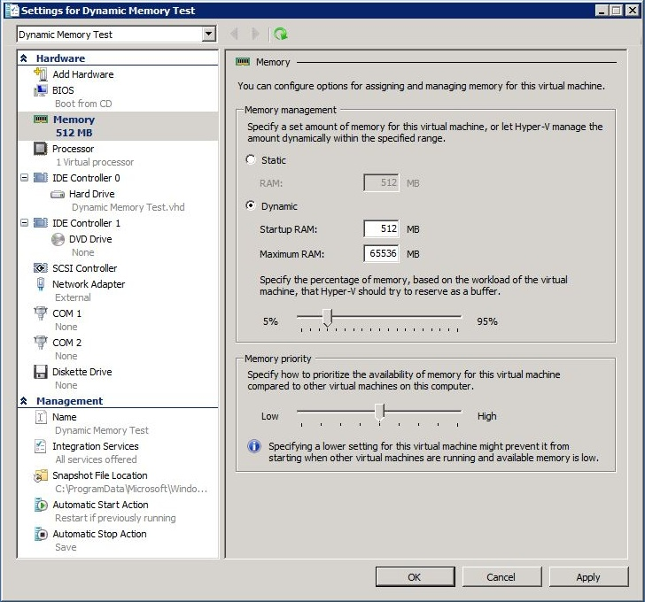
Dynamic Memory Settings
Startup RAM: Memory needed to boot VM
  Guest OS + Apps
  Default: 512MB
Maximum RAM: Memory limit for the VM
  Default: 64GB
Memory Buffer: Free memory to try to
maintain in the VM
  Enables responsiveness for workload bursts
  Allows use for file cache
Memory Priority: Order in which VMs are allocated memory
  Range: 1 (highest) - 10,000
  Default: 5,000
Notes:
If you select the static memory option, then you specify a set amount of memory for use by the virtual machine. If you select the dynamic memory option, then you must configure the Startup RAM, Maximum RAM, and Memory Buffer options.
The Startup RAM option defines the minimum amount of memory that is allocated to the virtual machine and reported to the guest operating system BIOS. In order to most effectively leverage dynamic memory, the Startup RAM should be configured to represent the amount of memory required by the virtual machine to startup and boot. If you configure dynamic memory for a guest operating system that does not support it, then the Startup RAM is the memory allocation that is assigned to the virtual machine, and there will be no attempt to dynamically manage the virtual machine memory. The Startup RAM option default is 512 MB.
The Maximum RAM option defines the peak amount of memory that can be allocated to the virtual machine. Even if the virtual machine reports that it requires more memory than the amount specified in the Maximum RAM setting, it will not be allocated more. The Maximum RAM option default is 64 GB.
The Memory Buffer option provides the ability to specify a percentage of additional memory to allocate to the virtual machine above what is required to run the workload. This additional memory can be used for file caching or used as needed when the virtual machine requires it. The actual memory buffer for a virtual machine may be lower than this setting depending on the amount of available memory in the system. The Memory Buffer option default is 20 percent, and should be adjusted based on the particular requirements of virtual machine workloads.
In addition, you can also specify a Memory Priority configuration for a virtual machine. This option allows you to prioritize the distribution of memory for a virtual machine with respect to other virtual machines on a host, if there is not enough available memory to satisfy all virtual machine requirements. The Memory Priority option ranges from Low to High and the default is a mid-range setting.

Slide 41

Storage
Virtual machines require storage for Virtual hard disk files, snapshots, Failover Clustering, and the application’s data files
Physical
  DAS (SATA, eSATA, PATA, SAS, SCSI, USB, Firewire)
  SAN (Fibre Channel, FCoE, iSCSI, SAS)
    Required for Failover Clustering so all nodes can access a disk
    Host Clustering: Fibre Channel, FCoE, Serial-Attached SCSI (SAS), iSCSI
    Guest Clustering: iSCSI
Virtual Adapters
  IDE, SCSI
  Boot – IDE only
VHD
  Fixed, dynamic, differencing
  Pass-through
  iSCSI Direct (Applicable to running iSCSI in guest OS)
Notes:
Highlight that, for the most part, Hyper-V can use any storage option for storing virtual machine files. The only exception is that network attached storage (NAS) is not supported.
Briefly summarize some of the ways in which virtual machines use storage. For now, mention that this information needs to be considered when planning the virtualization infrastructure. Later modules will provide much more detail on the planning implications for storage.
Virtual hard disks (VHD’s) in Hyper-V are similar to previous virtualization products. A VHD is a file, which appears as a physical disk to a virtual machine. Virtual machines can have multiple virtual hard disks, and virtual hard disks can be attached to different types of interfaces, such as IDE or SCSI.
Dynamically Expanding Disks
The size of this type virtual hard disk expands to a specified maximum size and does not automatically shrink when the data is deleted. Dynamically expanding disks offer the most efficient use of disk space, but incur a loss in performance when the hard disk has to expand to accommodate additional data. Dynamically expanding disks are best suited for test and development environments.
Fixed Size
This type virtual hard disk uses a fixed amount of space, regardless of the amount of data stored in it. Fixed size disks offer a greater storage cost, but do not suffer from a performance loss due to expansion. Fixed size disks are best suited for production virtual machines that require best possible performance.
When you create a fixed disk, you have the option to create a blank fixed size disk, or to copy the contents of an existing physical disk.
Dynamically Expanding Virtual Hard Disks
Dynamically expanding VHDs start off very small (just a few megabytes in size) and grow as data is written them. By default, Hyper-V creates dynamically-expanding virtual hard disks.
When you create a dynamically expanding virtual hard disk, you specify a maximum file size. The default maximum size is 127 gigabytes (GB), and they can be as large as 2 terabytes. The maximum size specified at creation restricts how large the virtual hard disk file size can grow. For example, if you create a 127 GB dynamically expanding virtual hard disk, the initial size of the .VHD file is about 3 megabytes (MB). As the virtual machine uses the virtual hard disk, the size of the .VHD file grows as data is written the VHD up to 127 GB. If you hit the limit, you can expand the size through the Hyper-V Disk Wizard.
Dynamic VHD Benefits
Efficient: Dynamically expanding virtual hard disks grow dynamically as the virtual machine needs more storage. Great for portability.
Dynamic VHD Drawbacks
Deferred storage allocation: Suppose you create 10 virtual machines with a maximum size of 100 GB each, and you place these on a 500-GB disk. These 10 virtual machines may all fit within 500 GB when you create them. However, over time, as those disks grow, it is possible that they outgrow storage because the disk resources are not allocated upfront.
Fragmentation and possibly slight performance impact: Because dynamically-expanding virtual hard disks grow only when needed, they tend to fragment easily. In addition, when the virtual hard disks grow, NTFS file system automatically zeros the new allocation (for security), which has a very small performance overhead.
Dynamic VHD Use Scenario
Dynamically expanding virtual hard disks are ideal for use in test and development environments, where performance is not always a factor.
Differencing disks store all state changes to a virtual machine or virtual hard disk in a separate file. This allows you to isolate changes to a virtual machine and keep a virtual hard disk in an unchanged state.
Virtual Server 2005 and Virtual PC 2007 use another disk type, called an undo disk. The main difference between an undo disk and a differencing disk is that undo disks apply to all virtual hard disks associated with a virtual machine, and a differencing disk applies to one virtual hard disk only. Windows Server® 2008 R2 Hyper-V does not include the undo disk type, but does introduce a new feature called a snapshot. A snapshot allows you to take a point-in-time snapshot of a virtual machine. All virtual machine state information is saved. At any time, you can revert the virtual machine back to that specific point in time.
Pass-through disks
With both dynamic and fixed-size virtual hard disks, the VHD is a file on disk. Pass-through disks are a different type of storage option where a Logical Unit Number (LUN) is associated with a virtual machine and the virtual machine writes directly to the LUN without encapsulation in a virtual hard disk. With pass-through disks, there is no VHD.
Pass-through disk benefits:
Performance: Like fixed-size disks, pass-through disks are very fast. Keep in mind that fixed-size virtual hard disks perform so well that they are about equal to pass-through disks. This is testament to the new Hyper-V driver architecture.
Support for greater than 2 terabytes per disk: VHDs are limited to 2 terabytes each. With pass-through disks, the limit per disk is whatever the guest operating system supports and the size of your physical storage.
Pass-through disk drawbacks:
Cannot use virtual machine snapshots: When you create a virtual machine snapshot, Hyper-V is asynchronously saving the state of a virtual machine and creating a differencing disk. You cannot do that with a physical disk.
Portability and encapsulation: VHDs encapsulate everything in files, which makes them portable.

Slide 42
Storage Options for VMs
IDE
SCSI
Two IDE controllers
Two devices each
Methods supported
  Pass-through
  Fixed-disk
  Dynamic
Emulated/synthetic
Must be used for boot partition
Four SCSI controllers
256 devices each
Methods supported
  Pass-through
  Fixed-disk
  Dynamic
Synthetic
Notes:
How is IDE and SCSI implemented in Hyper-V?
There are two types of disk controllers that Microsoft Hyper-V™ supports: small computer system interface (SCSI) and integrated development environment (IDE). There are two IDE controllers and four SCSI controllers available. Each IDE controller can have two devices. You cannot boot from a SCSI controller, so therefore, an IDE disk is required. If you want a CD-ROM drive, it will consume an IDE device slot. Each SCSI controller can support up to 64 devices. Both SCSI and IDE can support pass-through disks, fixed-size disks, and dynamic disks. The difference between IDE and SCSI is how you implement the controllers. The IDE controller is emulated or synthetic, whereas the SCSI controller is synthetic.
Synthetic and Emulated Devices
Synthetic devices are new with Hyper-V, and are designed to have the lowest overhead for devices. These devices package requests and forward them to the StorVSP driver in the root over the Virtual Machine BUS (VMBUS), which then forwards them to the device after any needed processing. Emulated devices, on the other hand, emulate a real piece of hardware. Emulation happens in the vmwp.exe process (one per VM).
The most important reason for having emulated devices is to support operating systems that do not have integration components installed. The emulated devices can also be thought of as boot-strapping devices since the preference should be to use the virtual devices. Keep in mind that the boot IDE drive uses a filter driver after boot for improved performance if integration components are installed. The synthetic devices are important because they help reduce the central processing unit (CPU) overhead when accessing a device. The IDE controller implements a well-known IDE controller and this means there is extra processing before the input/output (I/O) is sent to the disk.
The SCSI controller is synthetic, not emulated. The SCSI controller uses VMBUS (Virtual Machine BUS). The I/O's pass from the Guest Partition to the root over VMBUS and enter the I/O stack. Once and I/O completes its completion is sent over VMBUS. The VMBUS is a point-to-point memory bus that the Virtualization Service Provider (VSP) and Virtualization Service Client (VSC) use to communicate with each other.

Slide 43
Hot Add/Remove Storage
Overview
  Add and remove VHD and pass-through disks to a running VM without requiring a reboot
    Hot-add/remove disk applies to VHDs and pass-through disks attached to the virtual SCSI controller
Benefits
  Enables storage growth in VMs without downtime
  Enables additional datacenter backup scenarios
  Enables new SQL/Exchange scenarios
Notes:
Emphasize that this can add to high-availability by keeping VMs online while changing the storage configuration.

Slide 44
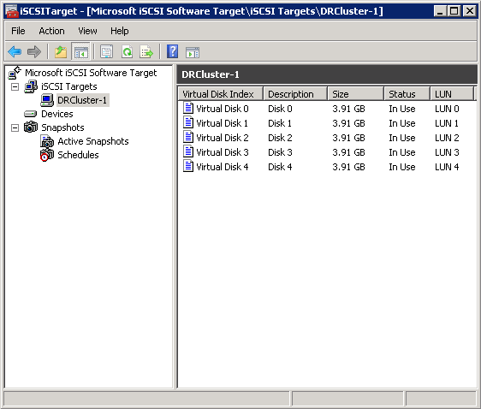
iSCSI Software Target
iSCSI is a cheap SAN solution
  Support Failover Clustering
  Required for Guest Failover Clustering
Uses the existing IP network
Can be a storage array or
DAS on a server
Free download:
http://www.microsoft.com/
download/en/details.aspx?
id=19867
Notes:
One of the storage technologies from Microsoft which we recommend exploring as part of the private cloud implementation is the iSCSI target. This has traditionally been released in exclusive storage only skus from Microsoft, however, for the first time Microsoft has now made this available to the public for free. Simply search Microsoft iSCSI target and you can find this free download. What the iSCSI does is it’s one of our four different types of SAN solutions which can be provided over ethernet. This means that if you want to go and deploy your private cloud, or even if you want to design a test infrastructure, a test implementation using this iSCSI target you now have a free storage solution. iSCSI fully supports failover clustering, and iSCSI is actually going to be required if you do what is known as guest clustering, which involves clustering virtual machines and making services failover between different VMs.
iSCSI exclusively uses the existing IP network and it can really use any type of storage available, and this can include direct attached storage or a storage array. You simply find these disks, you add them to the iSCSI target, and once they’re added to the iSCSI target, multiple servers can access them. So this is a great simple implementation, extremely cost effective and you’re going to see a demo of this deployment in the second module.

Slide 45
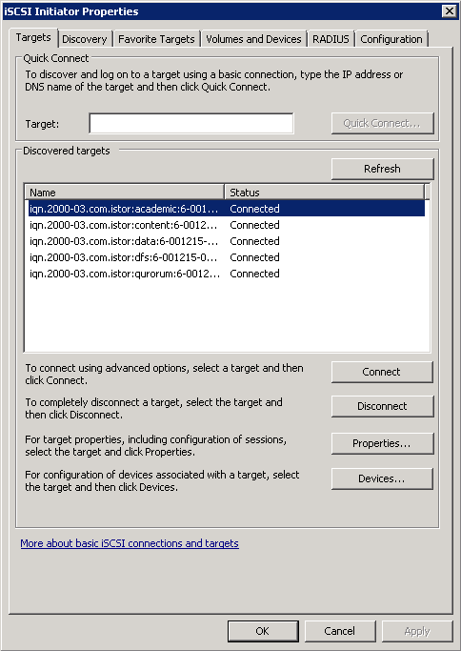
iSCSI Initiator
Initiator connects to the iSCSI Target
  Target must be configured
Should use a dedicated NIC
Can use any iSCSI Target
Notes:
Emphasize that Internet Small Computer System Interface (iSCSI) has become a viable alternative to fiber channel SANs as organizations have deployed networks that support multigigabyte per second connections. In most cases, iSCSI SANs are also cheaper than fiber channel based SANs and they do not require the same level of specialized skills to manage the SAN.
Now we talked about the iSCSI target as the component which receives the information this is what we deploy on the server that actually contains the storage, however to go and connect to that iSCSI target you need to use what is called an iSCSI initiator. The iSCIS initiator ships in box on all versions of Windows server and it can be used with any type of iSCSI target, not just the Microsoft iSCSI target. With the iSCSI initiator this is essentially our entry point to tell the server that it must connect to an iSCSI target somewhere. It’s always best to use a dedicated NIC and when you actually go and configure your target as soon as you hit the connect button you’re going to see a check box pop up which offers you the ability to have automatic reconnections if you loose the connection and is certainly a best practice to select this check box to ensure that any time there’s some type of interference with your storage or networking path and you lose contact with the iSCSI target that you can quickly and immediately reconnect to avoid any long term dis-interruption of service.
Configuring iSCSI
Target: Create virtual disks
Initiator(s): Request access to disks
Target: Accept access request from initiator(s)
Initiator(s): Refresh configuration to check connection
Initiator(s): Login to the target
Enable automatic reconnections
Servers: Initialize, format and bring disks online
Now you can use these disks for your VMs or cluster

Slide 46
Configuring iSCSI
Target: Create virtual disks
Initiator(s): Request access to disks
Target: Accept access request from initiator(s)
Initiator(s): Refresh configuration to check connection
Initiator(s): Login to the target
  Enable automatic reconnections
Servers: Initialize, format and bring disks online
Now you can use these disks for your VMs or cluster
Notes:
Microsoft iSCSI Initiator is installed natively on Windows Server 2008 R2, Windows 7, Windows Server 2008, and Windows Vista. On these operating systems, no installation steps are required.
Security
Microsoft iSCSI Initiator supports using and configuring Challenge Handshake Authentication Protocol (CHAP) and Internet Protocol security (IPsec). All supported iSCSI HBAs also support CHAP; however, some may not support IPsec.
The following best practices are recommended for your Microsoft iSCSI Initiator configuration:
Deploy on a fast network (a GigE or faster network).
Ensure physical security.
Use strong passwords for all accounts.
Use CHAP authentication because it ensures that each host has its own password. Mutual CHAP authentication is also recommended.
Use iSNS to discover and manage access to iSCSI targets.

Slide 47

Hyper-V Security Overview
Microsoft Hyper-V was designed to minimize the attack surface on the virtual environment
The hypervisor itself is isolated to a microkernel, independent of third-party drivers
Host portions of the Hyper-V activities are isolated in a parent partition, separate from each guest
The parent partition itself is a virtual machine
Each guest virtual machine operates in its own child partition
Use Server Core installation of Windows Server 2008 R2 for host computers
VMM provides additional security protection with role-based security and authorization policies
Notes:
Focus on how the hypervisor is separated from the host
Encourage people to use Server Core – a smaller attack surface leads to fewer patches, which leads to fewer vulnerabilities & patches, which leads to fewer reboots, which provides higher availability.

Slide 48
Security Best Practices - Host
Apply standard security policies to both host computers and VMs
Secure VHDs and snapshots files
Use BitLocker Drive Encryption to protect resources
Define networks or VLANs to isolate traffic
Leverage firewalls, anti-virus and intrusion protection as appropriate
Firewall rules configured during Hyper-V role installation or when adding a host via VMM
Consider using domain isolation with IP Security (IPSec) for both hosts and guests
Secure the communications between the Hyper-V server and its administrators and users
Notes:
Note that BitLocker is not supported on cluster disks

Slide 49
Security Best Practices - Guest
Only add required hardware to VM
Harden the OS in the VMs using security compliance toolkits
Install the latest Integration Services
Do not give VM administrators permissions on the management operating system
Keep VMs patched
  Remember VMs that are offline or templates
Notes:
Remember to patch both the host and guest OS

Slide 50

Overview
Microsoft’s standalone virtualization platform
Free download from www.microsoft.com/hvs
Streamlined and optimized for virtualization
  Hyper-V enabled at install time
  Local management interface is the command line, GUI through remote management
  Simple menu-based command line management interface
Full featured virtualization platform
  Same virtualization features as Windows Server 2008 R2 Enterprise
  Same physical host limits
  Does not include other server roles (Active Directory, File Server, IIS, etc.)
Licensing
  Fully activated on install, never expires
  Provides no licenses to run virtual machines
    Enterprise Edition: 4 guest licenses
    Datacenter Edition: unlimited guest licenses
Notes:
Microsoft Hyper-V Server 2008 R2 is the hypervisor-based server virtualization product that allows you to consolidate workloads onto a single physical server. It is a stand-alone product that provides a reliable and optimized virtualization solution enabling organizations to improve server utilization and reduce costs.
Since Hyper-V Server is a dedicated stand-alone product which contains only the Windows Hypervisor, Windows Server driver model, and virtualization components, it provides a small footprint and minimal overhead.
It easily plugs into existing IT environments, leveraging existing patching, provisioning, management, support tools, processes, and skills.

Slide 51
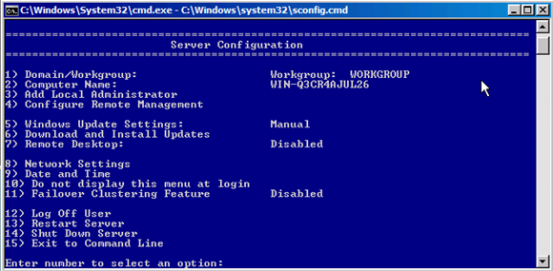
Benefits
More secure
  Smaller attack surface
  Fewer components need patching
High-Availability
  Failover Clustering support
  16 Nodes
  Cluster Shared Volumes
  Live Migration
Advanced Hyper-V Features
  Boot from USB
  RemoteFX
3rd Party Tools
Notes:
Enables workload consolidation
Provides a simplified virtualization solution
Works with existing IT Infrastructures
Capitalizes on existing processes

Slide 52
Configuration Best Practices
Configure remotely whenever possible
Join the host to a domain for easy authentication
  Required for clustering
Workgroups are more challenging
  Requires less infrastructure
  Likely requires use of free HVREMOTE script on client available from code.msdn.microsoft.com
Consider using Windows Thin PC SKU for VDI scenarios
  http://www.microsoft.com/windows/enterprise/solutions/virtualization/products/thinpc.aspx
Notes:
Use standard security and deployment best practices
Using AD is preferred over workgroups since it provides better security and access control

Slide 53
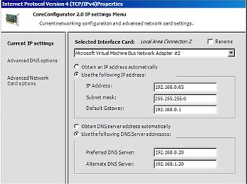
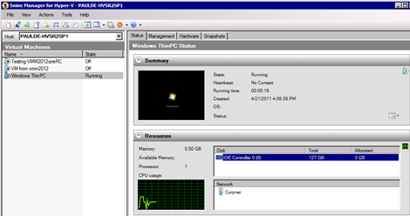
3rd Party Tools
Free GUI management tools available
Core Configurator
  Network Settings
  Firewall Settings
  Add/Remove Programs
  Add Drivers
  Download from www.codeplex.com
5nine Manager for Hyper-V
  Free Version has all GUI functionality of Hyper-V Manager, file manager, monitoring
  Full Version add the VM console and advanced network configuration
  Download from www.5nine.com
Use System Center for comprehensive virtualization management
Notes:
Many people resist using Hyper-V Server since it does not have a GUI, however not only can it be managed remotely (Hyper-V Manager, Failover Cluster Manager, VMM, RSAT), but there are several 3rd party tools which can be used to provide a GUI which sit on top of the basic Hyper-V Server Core installation.

Slide 54
Takeaways
Hyper-V Server 2008 R2 is a powerful hypervisor platform with Active Directory and Cluster support
It is free, but does not provide any guest OS licenses
There are numerous 3rd Party tools which add GUI management capabilities

Slide 55

Hyper-V Server 2008 R2
FREE virtualization host OS
Built on Server Core
High-availability Support
  16-node Failover Clustering
  Live Migration
  Cluster Shared Volumes
Command based
  Manage with GUI using Remote Server Administrator Tools (RSAT)
More information: http://www.microsoft.com/hyper-v-server/en/us/default.aspx
Notes:
So let’s talk a little bit more about the Hyper-V Server. As we mentioned, it is a free virtualization host. You could download it today by simply going to Microsoft.com/hvs to get additional information and links to go and download this. Since it’s built on Server Core, it has a reduced attack surface, meaning that a lot of additional components are not included, such as Internet Explorer. By having fewer components there are fewer items that need to be serviced and patched, hence there are going to be fewer updates that are required for this OS itself. So it has a lot of additional built in resiliency compared to a full edition of Windows Server already. Hyper-V Server also comes with a wealth of high availability features. It supports 16 node failover clustering, live migration and cluster shared volumes. So you still are able to use the Hyper-V Server as a core piece of your clustered fabric and your private cloud foundation. As we mentioned, it is command line based. However, you actually get prompted with an easy to use menu every time you launch Hyper-V Server, so using a simple numerical set of inputs you can change the domain, configure the computer name, adjust Windows Update settings, toggle the network settings, change the date and time and even enable clustering or remote desktop connections.

